Slide 1
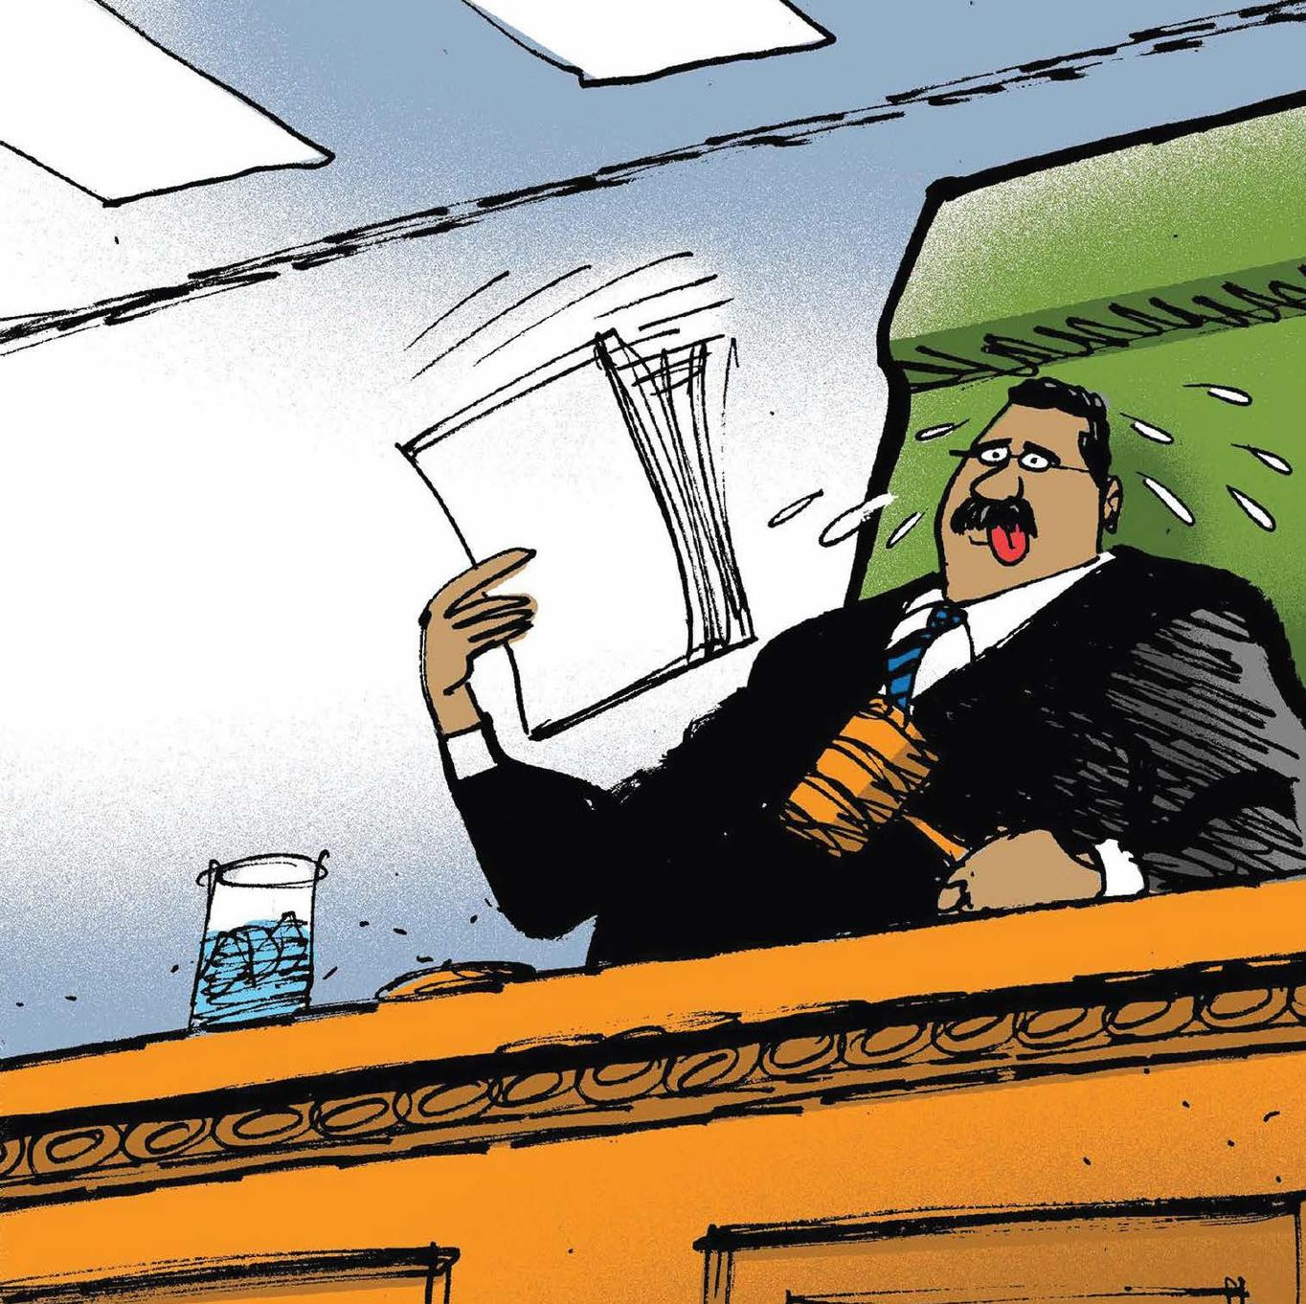
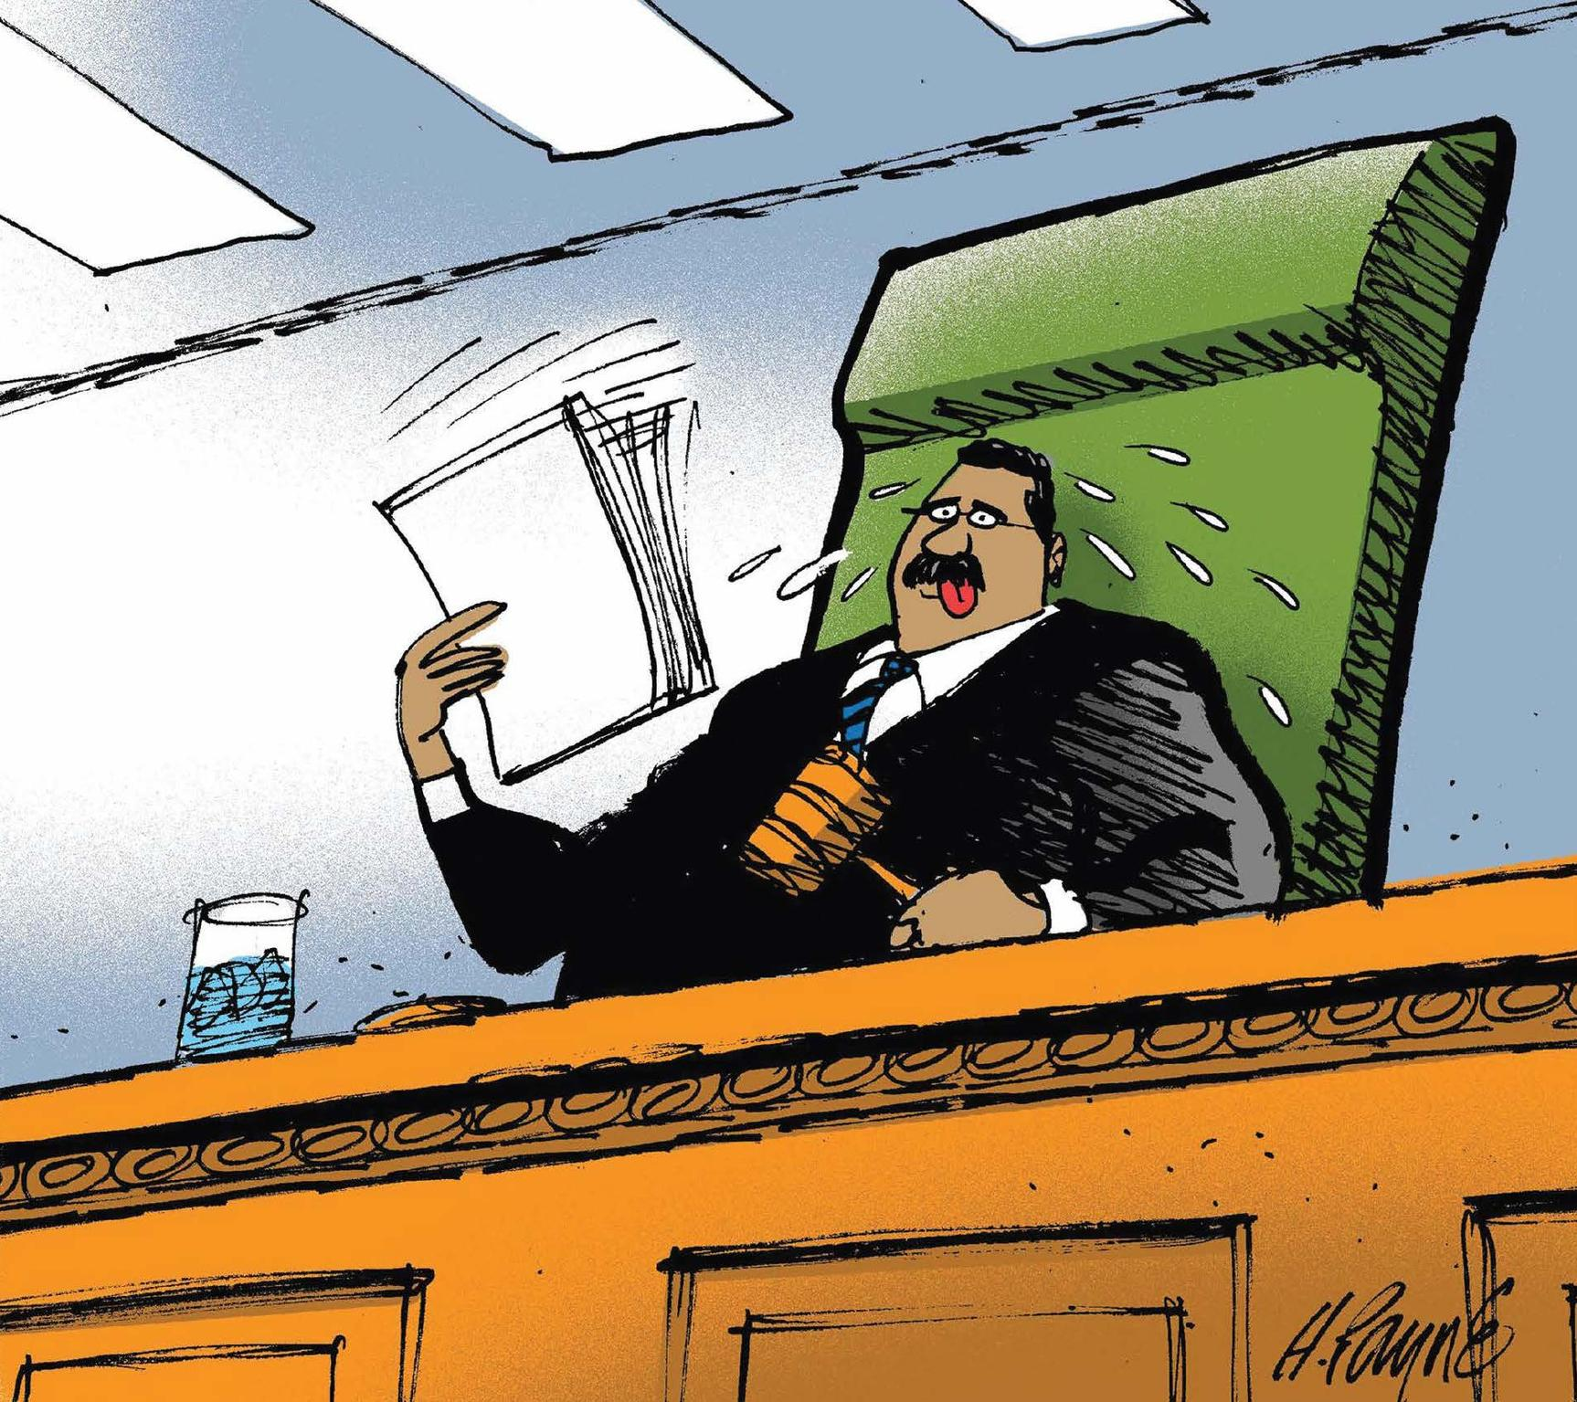

CLIMATE SCIENCE AND LAW FOR JUDGES:
CLIMATE LITIGATION 101
Updated: March 2026

Slide 2

ROADMAP
1
CLIMATE CASES
BY THE NUMBERS
  2
  LEGAL LANDSCAPE
  3
  ROLE OF CLIMATE SCIENCE IN CLIMATE LITIGATION

Slide 3

  1
CLIMATE CASES
BY THE NUMBERS

Slide 4
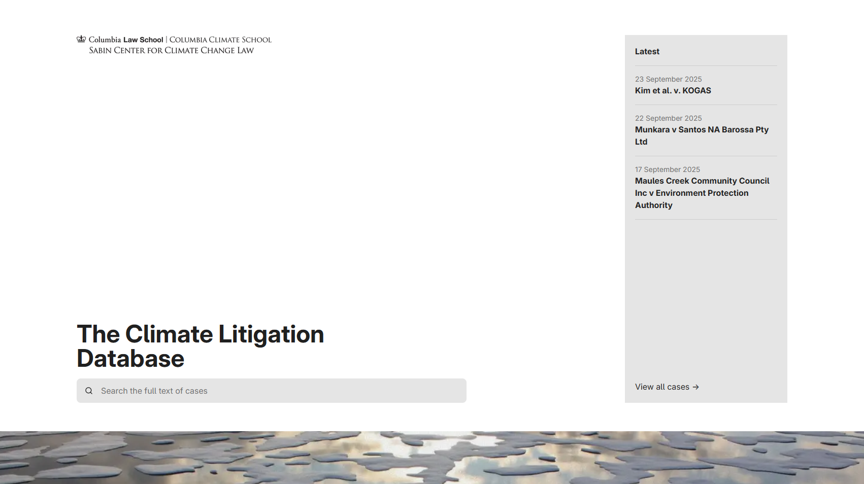
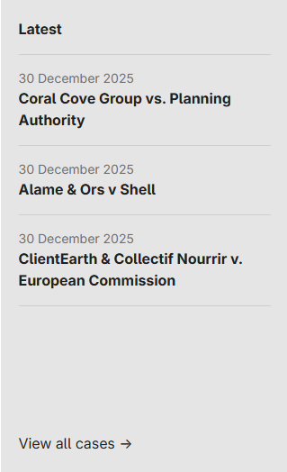
1
CLIMATE CASES BY THE NUMBERS
CLIMATE LITIGATION DATABASE
COLUMBIA LAW SCHOOL SABIN CENTER FOR CLIMATE CHANGE LAW
http://climatecasechart.com/

Slide 5

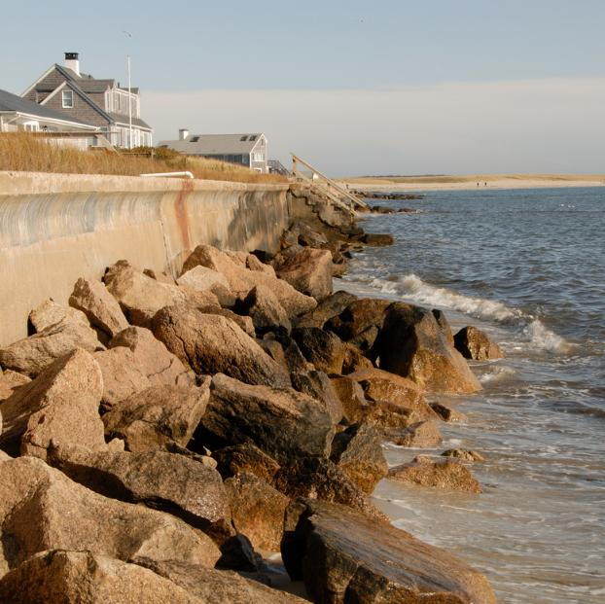
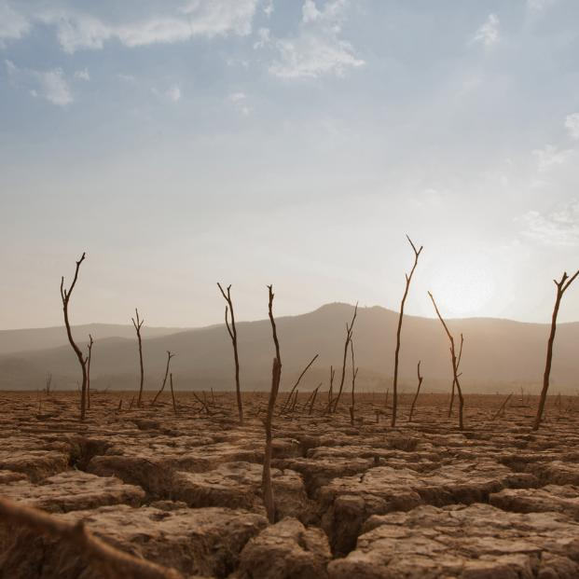
  For more, see the Overview of Climate Litigation module.
TYPES OF CLIMATE CASES
MITIGATION
ADAPTATION &
RISK MANAGEMENT
IMPACTS
cases involve the amount of greenhouse gases in the atmosphere
cases involve reducing or compensating for harm caused by the effects of climate change
cases involve financial, physical, and other risks posed by a changing climate

Slide 6
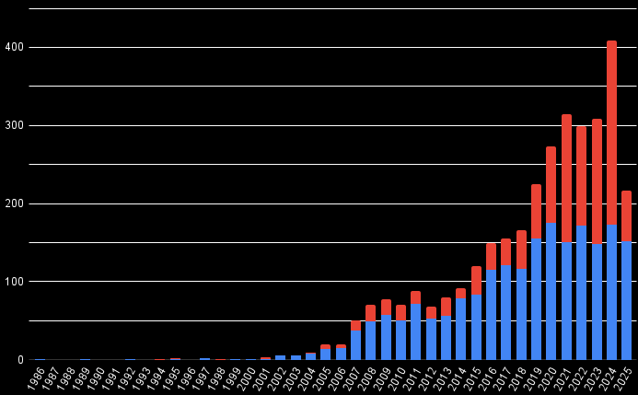
  For more, see the Overview of Climate Litigation module.
CLIMATE CASES* OVER TIME
Climate Cases by Year Filed
3,300+
CASES AS OF JANUARY 2026
*
To be counted in this chart, an entry must:
(1) be judicial or quasi-judicial
(2) climate change law, policy, or science must be a material issue of law or fact
For a detailed explanation of methodology, see https://www.climatecasechart.com/methodology
U.S. Litigation
Global Litigation
No. of Cases Filed
Year
Based on data from Sabin Center for Climate Change Law Climate Litigation Database, compiled January 2026.

Slide 7
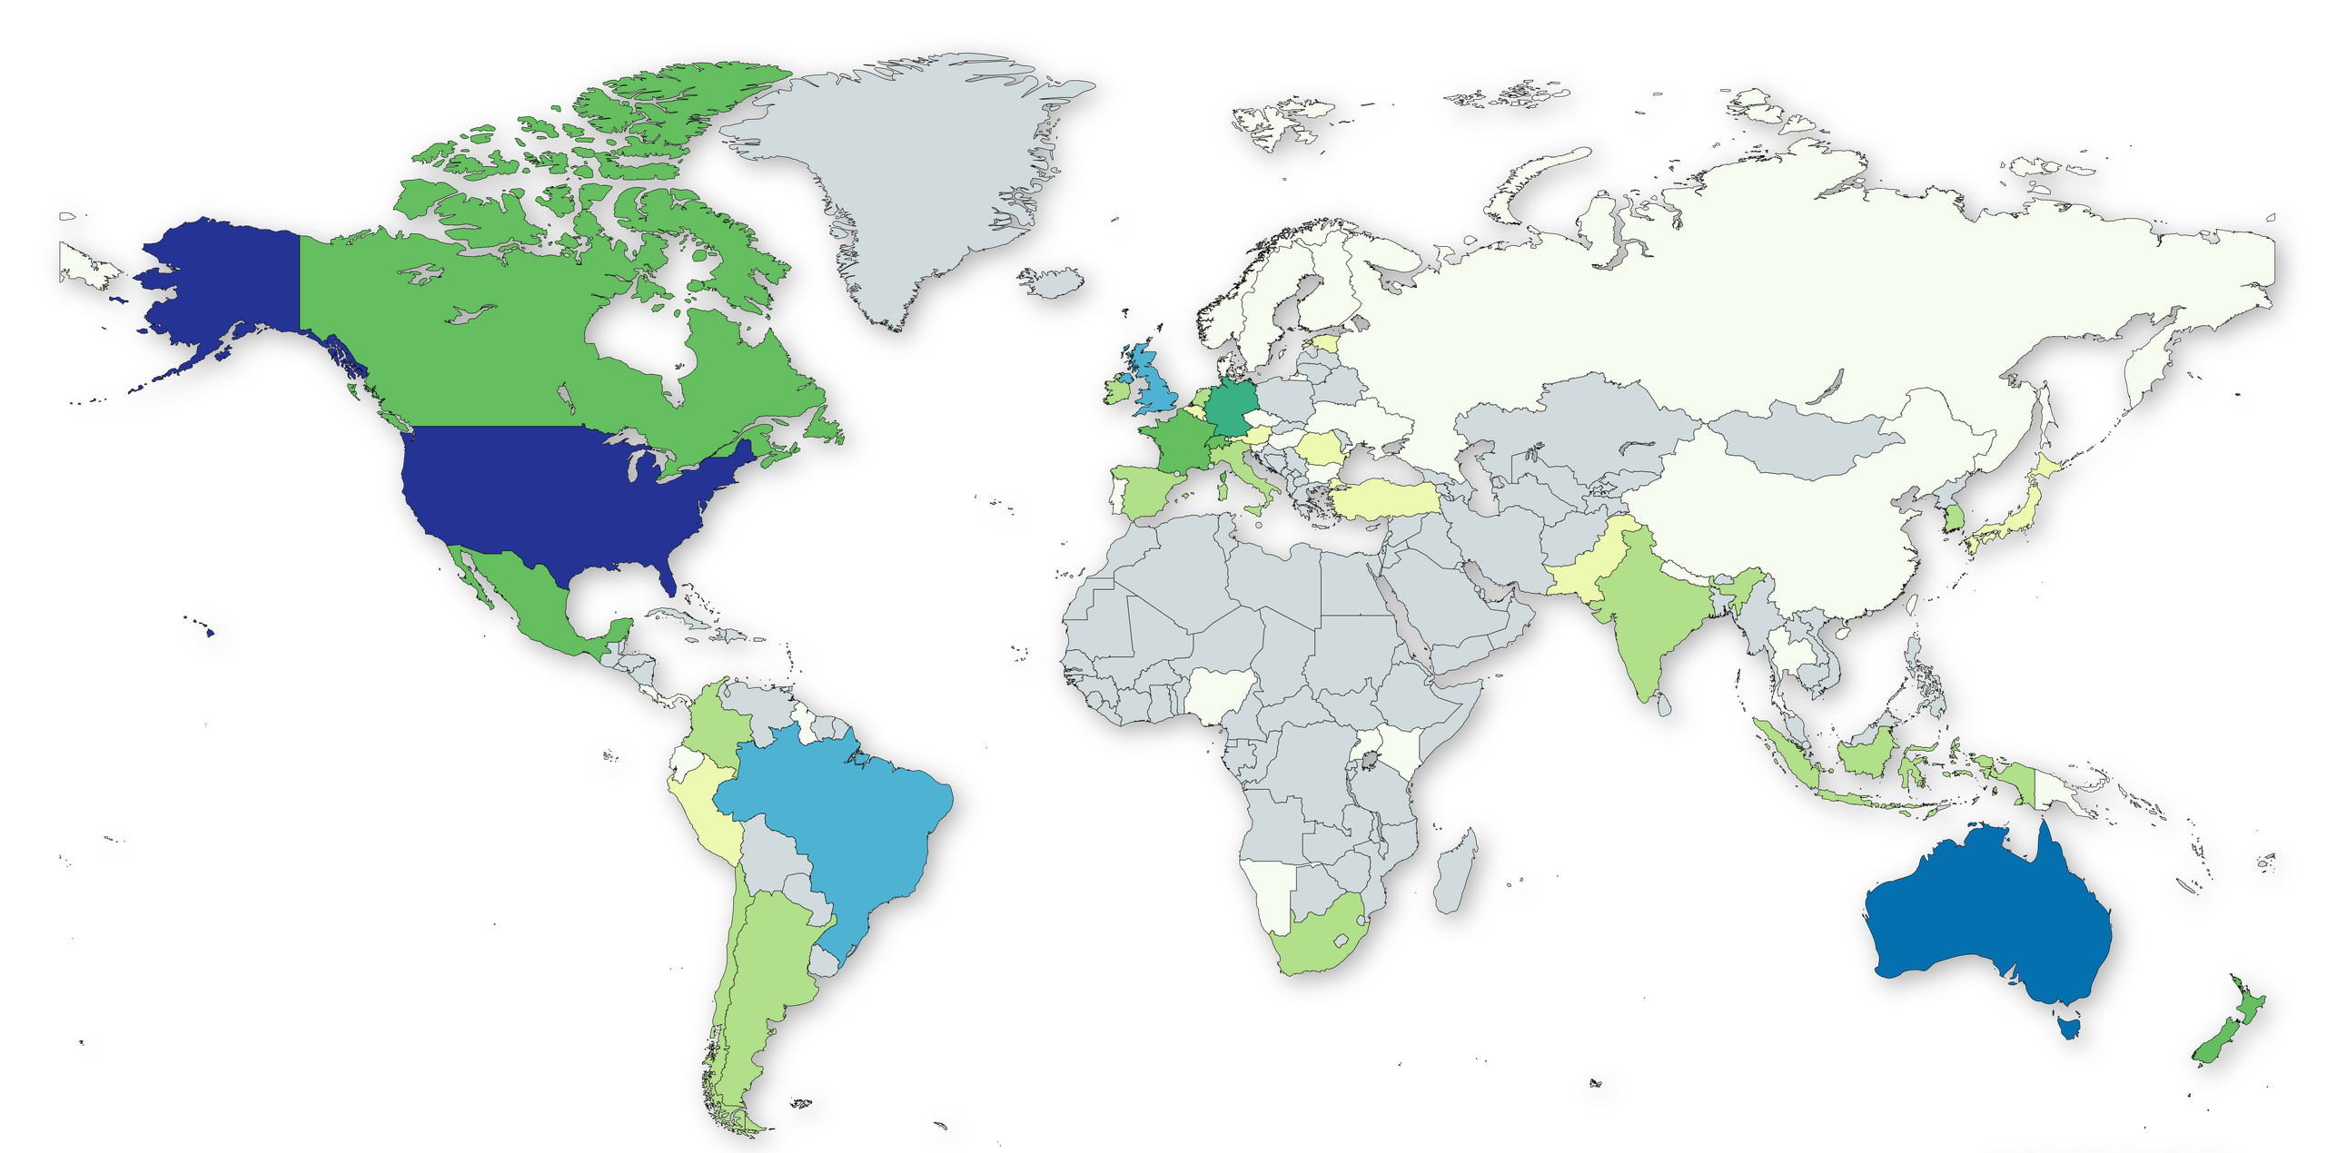
CLIMATE CASES BY COUNTRY
Number of climate cases
0
51-100
1-5
101-200
6-10
166 (Australia)
11-20
1993 (U.S.)
21-50
Based on data from Sabin Center for Climate Change Law Climate Litigation Database, compiled August 2025.

Slide 8
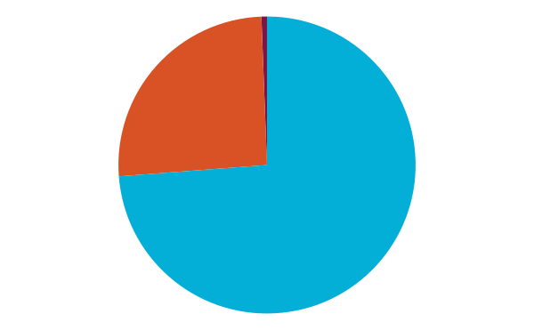
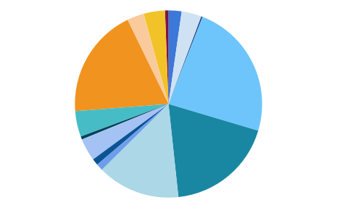
  For more, see the Overview of Climate Litigation module.
GLOBAL CLIMATE CASES BY CLAIM
Advisory Opinions, 0.5%
Access to Information, 2.3%
Other, 3.7%
Energy and Power, 3.5%
Protestors, 2.9%
Environmental Crimes, 0.2%
Corporations, 19%
Environmental Assessment & Permitting, 23.7%
Trade & Investment, 4.4%
Public Trust, 0.5%
Public Assembly, 0.1%
Protecting Biodiversity & Ecosystems, 3.8%
GHG Emissions Reduction & Trading, 18.7%
Failure to Adapt, 1.1%
Just Transition, 1.2%
Suits Against Governments, 73.8%
Human Rights, 14.3%
Suits Against Corps., Individuals, 25.6%
Advisory Opinions, 0.6%
Based on data from Sabin Center for Climate Change Law Climate Litigation Database, compiled August 2025.

Slide 9
U.S. CLIMATE CASE TRENDS
The United States has the greatest number of climate cases globally. Examples of current trends in state and federal courts include:
TREND
EXAMPLES
Challenges to federal climate regulations
  Changes in agency funding, staffing, and enforcement
  EPA rules on clean power​
  EPA, NHTSA vehicle emissions rules​; California waiver
Suits by state and local governments against energy companies
  E.g., Vermont, New Jersey, Minnesota, California​
  E.g., Boulder City and County, CO; Multnomah County, OR
  Heat and health
  Sea-level rise and coastal land management
  Hurricanes and insurance
Climate impacts/extreme events
Challenges related to the energy transition
  Fossil fuels and renewables​
  Permitting impacts on aesthetics, property, and wildlife
  E.g., Save North Livermore Valley v. County of Alameda

Slide 10
For more, see the Overview of European Climate Litigation module.
EUROPE CLIMATE CASE TRENDS
After the United States, European courts account for the greatest number of climate cases. Examples of expected trends in national and international courts in Europe include:
TREND
EXAMPLES
  Private claims seeking compensation for loss and damage
  Group litigation by extreme weather victims (e.g., Bushfire Survivors for Climate Action Incorporated v. Environmental Protection Authority)
Extreme weather events
Greenhouse gases beyond carbon dioxide
  Short-lived climate pollutants as subject of litigation
  Black carbon cases
  Contestation of Mestre-Trieste methane pipeline
Individual and corporate responsibility
  Duties and responsibilities of individual actors
  Individuals working in the fossil fuel industry, among others
  ClientEarth’s pre-action letter to Shell’s Board of Directors
  Challenges to authorized forest-felling permits in Estonia
  UK factory farming and Amazon deforestation arguments in Humane Being v. United Kingdom
Forests and food systems

Slide 11

  2
LEGAL LANDSCAPE

Slide 12
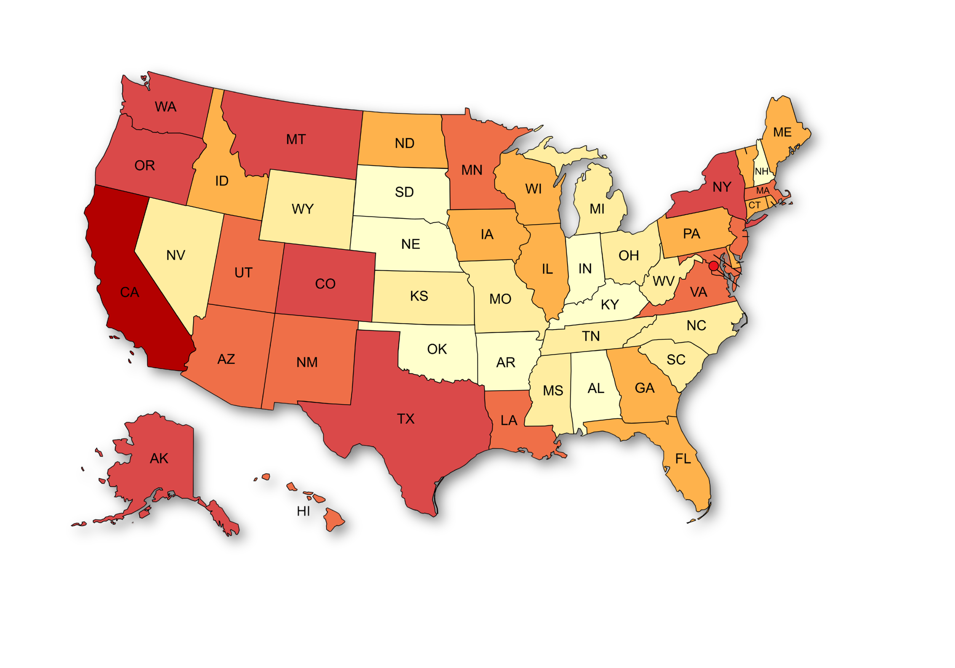




  For more, see the Overview of Climate Litigation module.
CLIMATE CASES BY STATE
(STATE & FEDERAL COURTS)
Number of climate cases*
1-5
VT
6-10
11-25
26-50
RI
51-129
NJ
235 (DC)
DE
MD
556 (CA)
DC
This map is based on cases in state courts, before state agencies, and in federal district courts.
It does not include cases in U.S. federal courts of appeals.
*some cases may be counted more than once if they appeared before more than one court.
GU
HI
PR
VI
PR
Based on data from Sabin Center for Climate Change Law Climate Litigation Database, compiled August 2025.

Slide 13

  For more, see the Overview of Climate Litigation module.
U.S. CLIMATE CASES BY CLAIM
Climate Change Protesters and Scientists, 2.4%
Carbon Offsets and Credits, 2.2%
Adaptation, 6.9%
Trade Agreements, 0.1%
Securities and Financial Regulation, 1.7%
Clean Air Act, 7.8%
Public Trust, 1.3%
Endangered Species Act and Other Wildlife Protection Statutes, 9.6%
Common-Law Claims, 1.6%
Clean Water Act, 2.7%
Other State Law Case Categories, 10.9%
State Utility Regulation, 2.3%
National Environmental Policy Act, 16.6%
State Environmental Review “Little NEPA”, 11.7%
Freedom of Information Act, 3.9%
Constitutional, 7.4%
Other Federal Statutes, 11.0%
Based on data from Sabin Center for Climate Change Law Climate Litigation Database, compiled August 2025.

Slide 14
  For more, see the Overview of Climate Litigation module.
ANOTHER CONCEPTION OF CLIMATE LITIGATION
Litigation with no specific climate change framing but with implications for mitigation or adaptation
Litigation with climate change as one motivation, but not raised as an issue
Climate change intersects with litigation in various ways.
Climate impacts—and other non-environmental laws and policies that have climate implications—can lead to litigation, even without climate as a central issue.
Litigation with climate change as a peripheral issue
Litigation with climate change as the central issue
Adapted from Jacqueline Peel and Hari M. Osofsky, Climate Change Litigation (2020) (Figure 1).

Slide 15
For more, see the Government Action and Overview of Climate Litigation modules.
NATIONAL ENVIRONMENTAL
POLICY ACT (NEPA)
NEPA claims are the most common among all U.S. climate cases. For example, under NEPA, courts have examined whether agencies have adequately:
Accounted for the greenhouse gas emissions of a proposed project
Evaluated effects of climate change on federal lands
Citizens for a Healthy Cnty. v. U.S. BLM
AquaAlliance v. Bureau of Reclamation
377 F. Supp. 3d 1223 (D. Colo. 2019)
287 F. Supp. 3d 969, 1023-24 (E.D. Cal. 2018)
The U.S. Supreme Court’s Seven County Infrastructure Coalition v. Surface Transp. Bd. (2025) decision will likely serve as a guidepost for lower courts reviewing how far removed in time and place an agency must go in evaluating the environmental impacts of a proposed project. The decision is relevant to NEPA climate cases because the climate impacts from a given project do not always manifest nearby in space and time.

Slide 16

For more, see the Government Action module.
GOVERNMENT ACTION
STATE IMPACT ASSESSMENTS
The same general principles that apply in NEPA reviews typically apply to states with robust environmental framework laws.
Some states have also introduced more targeted regulations or guidance on the consideration of GHG emissions and climate change impacts under their EIA laws.
  California, New York, and Massachusetts require disclosure of direct and indirect GHG emissions from proposals undergoing EIAs.
Sierra Club v. County of San Diego (Cal. Super. Ct. 2021)

Slide 17

For more, see the Government Action module.
WILDLIFE AND HABITAT
Some of the most in-depth discussion of climate science occurs in climate cases involving the Endangered Species Act.
Contemporary Climate Impacts
Future Climate Impacts
Reveals how climate change is affecting species and habitats and the extent to which they have already been affected
Provides future climate trends and the long-term viability of species in light of these trends
  Endangered and threatened species listing decisions
  Critical habitat designations
  Biological assessments, jeopardy determinations, and recovery plans

Slide 18
U.S. CLIMATE CASE TRENDS
TREND
EXAMPLES
Challenges to federal climate regulations
  Changes in agency funding, staffing, and enforcement
  EPA rules on clean power​
  EPA, NHTSA vehicle emissions rules​; California waiver
Suits by state and local governments against energy companies
  E.g., Vermont, New Jersey, Minnesota, California​
  E.g., Boulder City and County, CO; Multnomah County, OR
  Heat and health
  Sea-level rise and coastal land management
  Hurricanes and insurance
Climate impacts/extreme events
Challenges related to the energy transition
  Fossil fuels and renewables​
  Permitting impacts on aesthetics, property, and wildlife
  E.g., Save North Livermore Valley v. County of Alameda

Slide 19

  For more, see the Overview of Climate Litigation module.
FEDERAL CLIMATE REGULATIONS
Numerous federal agencies in recent years, through regulations or guidance documents, have incorporated climate change considerations into their decisionmaking.
THE UNCERTAIN FUTURE OF EPA’S
ENDANGERMENT FINDING
In February 2026, EPA rescinded its landmark 2009 endangerment finding. Undoing the finding dramatically reduces the federal government’s ability to regulate greenhouse gas emissions (GHGs).
The EPA based its decision on a reinterpretation of the Clean Air Act (CAA) and the rejection of the legal reasoning underlying the original 2009 finding. EPA further concluded that GHG emissions from U.S. motor vehicles account for too minor of a share of global emissions to warrant regulation under the CAA.
The repeal is currently facing multiple legal challenges in the D.C. Circuit.
While the continued vitality of those federal agency actions is currently in significant question, many of them have resulted in litigation, such as:
  Adjustments to the “social cost of carbon”
  Revisions to NEPA regulations
  Fossil-fuel leasing on public lands
  Office of Management and Budget (OMB) guidance
  U.S. Securities and Exchange Commission climate risk disclosure rules

Slide 20
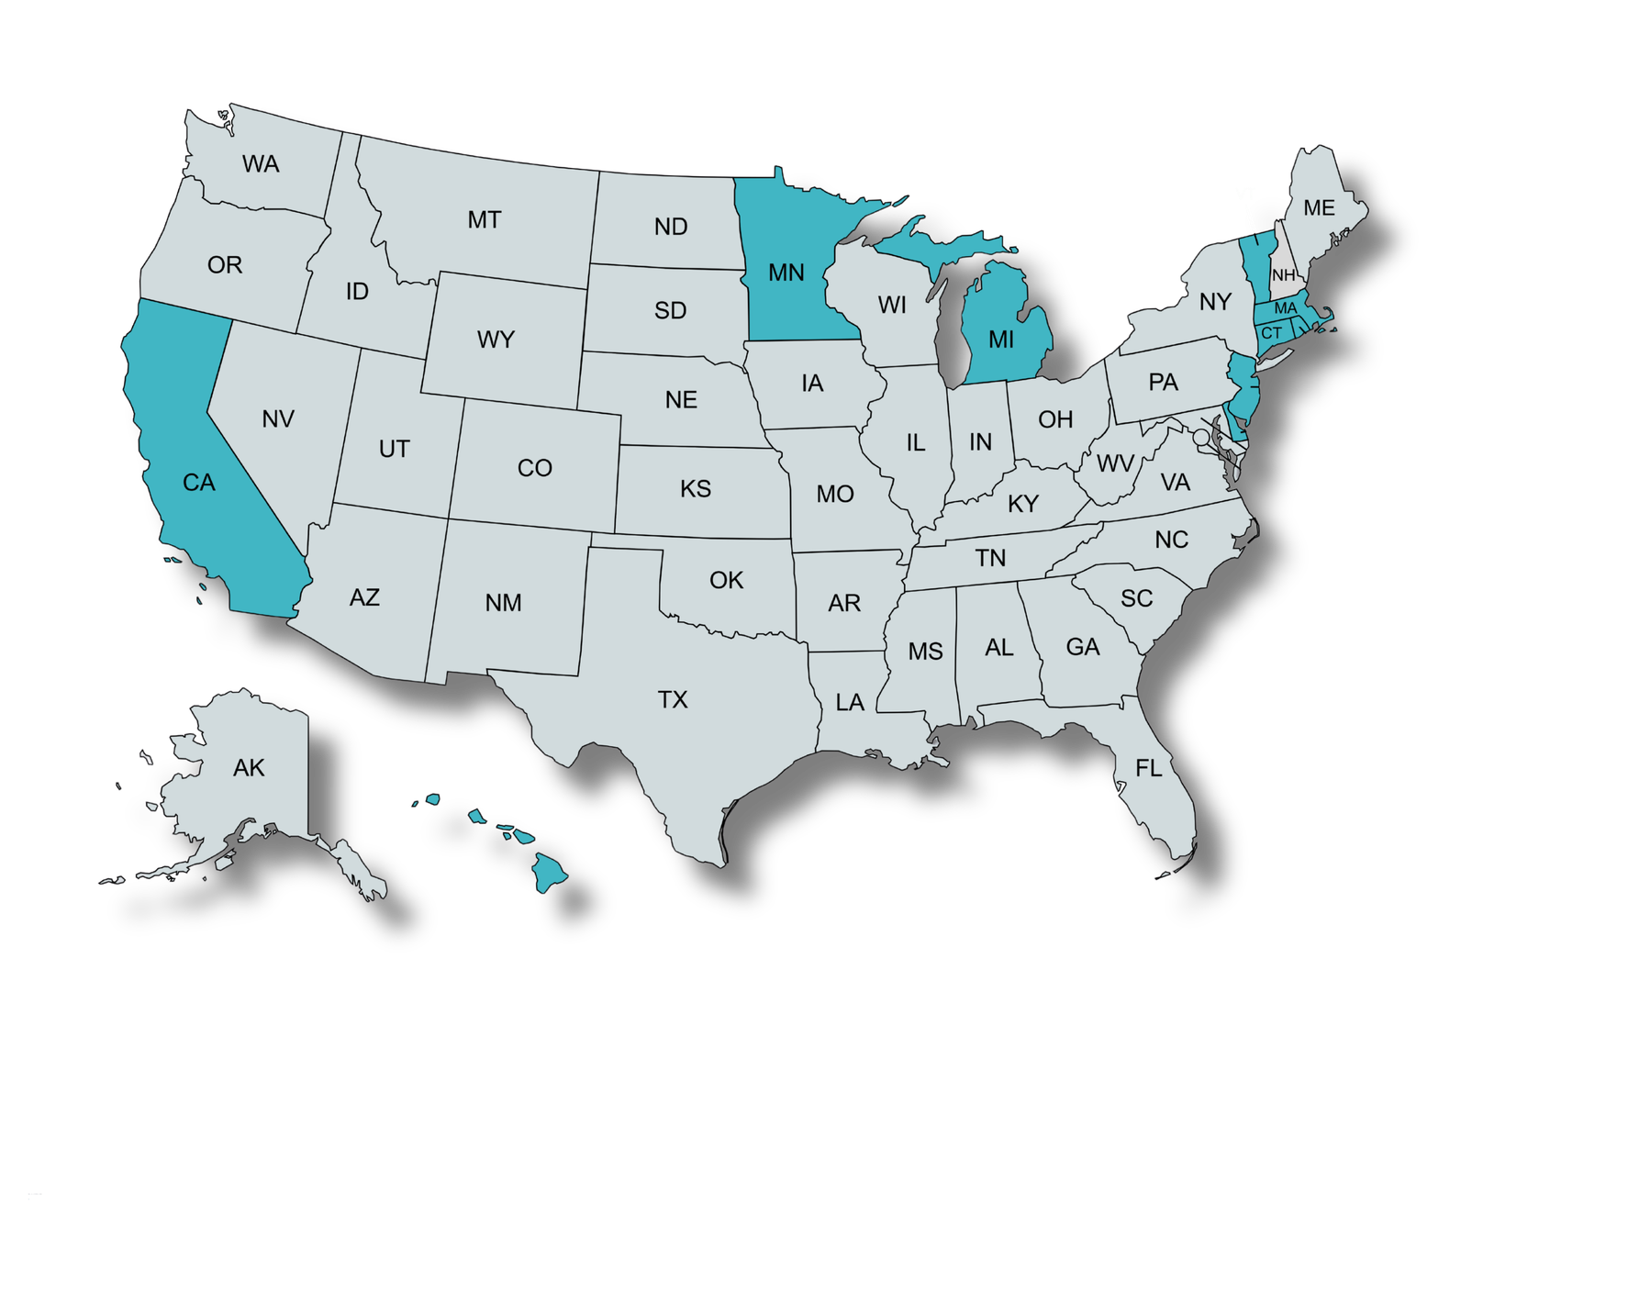

STATE AND LOCAL GOVERNMENTS V. FOSSIL FUEL COMPANIES
State or Territory filed
City, County, and/or Tribal Government filed
Makah Indian Tribe
Shoalwater Bay Indian Tribe
Boulder City and County, CO
San Miguel County, CO
Chicago, IL
VT
Multnomah County, OR
Hoboken, NJ
Marin County, CA
RI
New York City, NY
NJ
DE
Bucks County, PA
Richmond, CA
San Francisco, CA
Oakland, CA
San Mateo County, CA
MD
DC
Anne Arundel County, MD
Baltimore, MD
Annapolis, MD
Imperial Beach, CA
Charleston, SC
HI
Honolulu City and County, HI
Maui County, HI
PR
Bayamón, PR
San Juan, PR
Based on data from Sabin Center for Climate Change Law Climate Litigation Database, compiled January 2026.

Slide 21
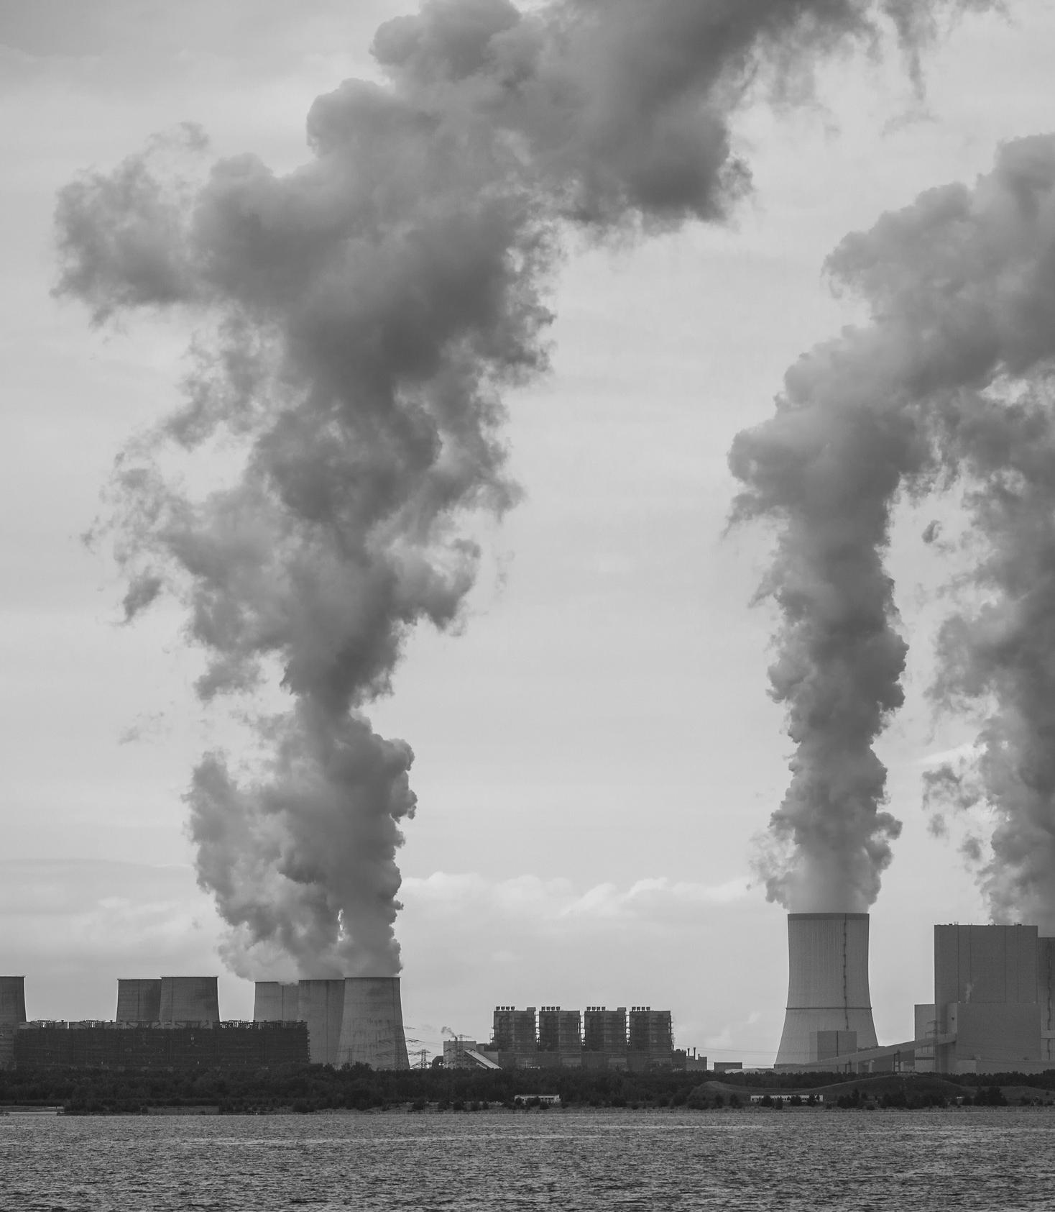

For more, see the Procedural Techniques and Overview of Climate Litigation modules.
STATE AND LOCAL GOVERNMENTS V. FOSSIL FUEL COMPANIES
State Court Decisions on Dismissals
STATE | CASE | DATE
MA | Commonwealth of Mass. v. Exxon Mobil Corp. | Jun. 2021
HI | City & County of Honolulu v. Sunoco LP | Oct. 2023
NJ | City of Hoboken v. Exxon Mobil Corp. | Oct. 2023
DE | Delaware v. BP America Inc. | Jan. 2024
CO | Bd. of County Commissioners of Boulder County v. Suncor Energy (U.S.A.), Inc. | Jun. 2024
MD | Mayor & City Council of Baltimore v. BP p.l.c. | Jun. 2024
CT | Connecticut v. Exxon Mobil Corp. | Jun. 2024
CA | Fuel Industry Climate Cases | Oct. 2024
VT | Vermont v. Exxon Mobil Corp. | Dec. 2024
MD | City of Annapolis v. BP p.l.c. and Anne Arundel County v. BP p.l.c. | Jan. 2025
NY | City of New York v. Exxon Mobil Corp. | Jan. 2025
NJ | Platkin v. Exxon Mobil Corp. | Feb. 2025
MN | State of Minnesota v. American Petroleum Institute | Feb. 2025
DC | District of Columbia v. Exxon Mobil Corp. | Apr. 2025
PA | Bucks County v. BP p.l.c et al. | May. 2025
SC | City of Charleston v. Brabham Oil Co. et al. | Aug. 2025
PR | Municipality of Bayamón v. Exxon Mobil Corp. | Sep. 2025
PR | Municipality of San Juan v. Exxon Mobil Corp. | Sep. 2025
At first, these cases focused on whether they belonged in state court or federal court. Federal courts ruling on the jurisdictional issue have uniformly held that these cases are properly heard in state court.
Many of these suits are now proceeding in state courts, and state courts ruling on motions to dismiss are split.
Granted
Next up...
Granted in part, denied in part
U.S. Supreme Court
granted cert. petition in City and County of Boulder
Denied

Slide 22
For more, see the Applying Attribution module.
STATE AND LOCAL GOVERNMENTS V. FOSSIL FUEL COMPANIES
These examples illustrate that different courts have reached different outcomes.
City of New York v. Chevron Corp.
(2d Cir. 2021)
City & County of Honolulu v. Sunoco LP (Haw. 2023)
The Second Circuit dismissed a lawsuit involving state-law claims filed in federal court. The panel held that “[g]lobal warming presents a uniquely international problem of national concern” that can only be addressed by federal or international law, rather than state common law. The panel then held that federal common law is displaced by the CAA (Clean Air Act), even when a litigant merely pursues a claim for damages rather than injunctive relief.
The Hawaii Supreme Court affirmed the denial of the defendants’ motions to dismiss, allowing the plaintiffs’ state-law claims to proceed. The court held that personal jurisdiction over the defendants was proper because the claims arise out of the sale and promotion of the defendants’ products in Hawaii. The court found that while the CAA displaces federal common law, it does not displace state common law, and even if it were not displaced, preemption would still fail since the plaintiffs did not seek to regulate emissions.

Slide 23








  For more, see the Overview of Climate Litigation module.
CLIMATE IMPACTS
Changing Precipitation Patterns
more intense...
Declining Air Quality
Declining Water Quality
Heat
CLIMATE CHANGE
Increasing Severity of Hurricanes & Tropical Storms
Increasing Severity of Wildfires
Longer and More Severe Droughts
Sea-Level Rise
and more frequent...

Slide 24
impacts raise many issues...
Hurricane preparation
Hurricane damages
Post-hurricane construction
Planning and preparation
Unsafe heat exposure
Flood damages
Water entitlement and rights transfer
Planning and siting
CLIMATE CHANGE
Water overconsumption, misuse, misappropriation
Ecosystem impacts
Agriculture and land use
Property impacts
Water quality
Public health risks
Land use
Wildfire mitigation
Unsafe wildfire exposure

Slide 25
Stewart v. Entergy Corp.
and lead to cases...
Conservation Law Foundation v. Gulf Oil LP
Lauridsen Family Limited Partnership v. Zoning Board of Appeals of Town of Greenwich
Md. Small MS4 Coal v. Md. Dep’t of Env’t
Tiede v. Collier
Hurricane preparation
Hurricane damages
Post-hurricane construction
Illinois Farmers Insurance Co. v. Metropolitan Water Reclamation District of Greater Chicago - Climate Change Litigation
Unsafe heat exposure
Planning and Preparation
Flood damages
County of Mohave v. U.S. Bureau of Reclamation
Greenroots, Inc. v. Energy Facility Siting Board
Water entitlement and rights transfer
CLIMATE CHANGE
Planning and siting
Aquifer Science, LLC v. Verhines
Water overconsumption, misuse, misappropriation
Ecosystem impacts
Sierra Club v. Von Kolnitz
Agriculture and
land use
Property impacts
Western Watersheds Project v. Perdue
Lindstrom v. California Coastal Commission
Water quality
Public health risks
Northwest Environmental Advocates v. EPA
GreenLatinos Colorado et al. v. Colorado Air Quality Commission
Land use
Wildfire mitigation
Unsafe wildfire exposure
Preserve Wild Santee v. City of Santee
Oregon Manufacturers & Commerce v. Oregon Occupational Safety & Health Division - Climate Change Litigation
Klamath-Siskiyou Wildlands Center v. Grantham

Slide 26
IMPACTS/EXTREME EVENTS
Litigation fallout from climate impacts, including those from extreme events:
HURRICANES
EXTREME HEAT
SEA-LEVEL RISE
Preparation, damages, and recovery
A single event can result in thousands of insurance cases
Health and safety
Relevant for private employers and public institutions alike
Property, services, and habitat
Adaptation actions affect coastal land management
Hurricane Maria, 2017
Tiede v. Collier, 796 F.Supp.3d 275 (W.D. Tex. 2025)
Lucas v. South Carolina Coastal Council, 505 U.S. 1003 (1992)

Slide 27
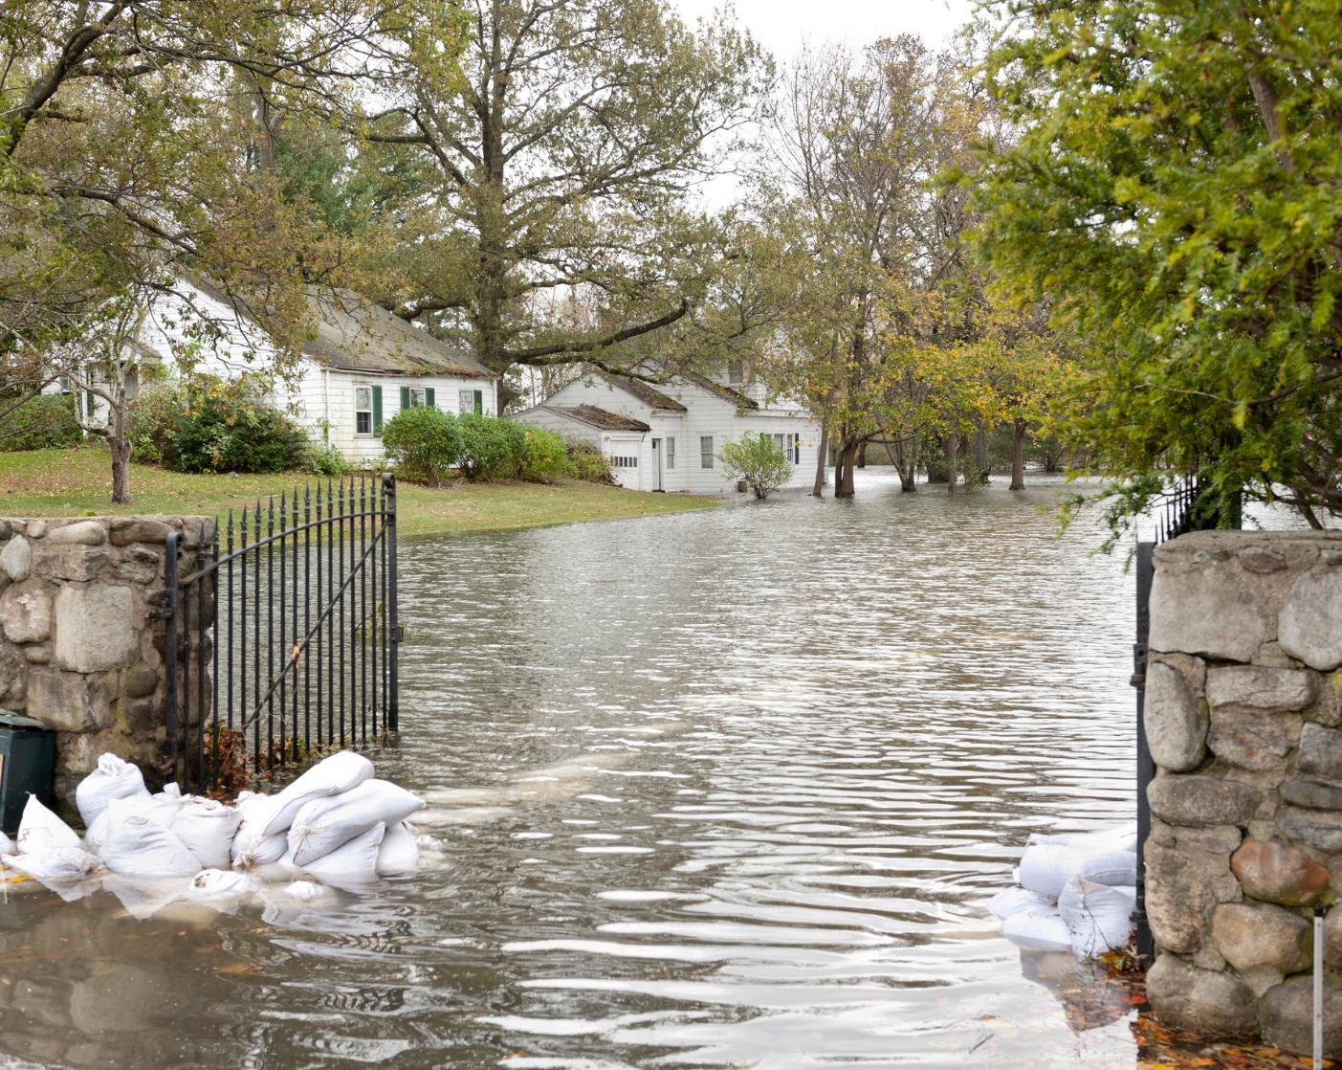
CLIMATE IMPACTS
One study investigated how much of the more than $60 billion in damages from Hurricane Sandy can be linked to climate-related anthropogenic sea-level rise, finding:
$8
billion
71,000
additional people impacted
in additional damages
Strauss, B.H., Orton, P.M., Bittermann, K. et al. Economic damages from Hurricane Sandy attributable to sea level rise caused by anthropogenic climate change. Nat Commun 12, 2720 (2021). https://doi.org/10.1038/s41467-021-22838-1
Calculating climate damages from Hurricane Sandy

Slide 28

For more, see the Sea Level Rise module.
SEA-LEVEL RISE
In the wake of accelerating sea-level rise, impacts to residents, critical infrastructure, property, and ecosystems are resulting in legal challenges, with a particular focus on:
  Justiciability and Standing
  Administrative Decisionmaking
  Land Use and Zoning
  Physical and Regulatory Takings
  Shifting Property Boundaries

Slide 29

For more, see the Sea Level Rise module.
SEA-LEVEL RISE
ADMINISTRATIVE DECISIONMAKING
Martin v. California Coastal Commission
(Cal. Ct. App. 2021)
  A California appellate court upheld an order from the California Coastal Commission that required new residences in the City of Encinitas to be set back 79 feet from an oceanside bluff.
  The plaintiffs challenged the state’s assumed rates of sea-level rise and coastal erosion with data from a geotechnical consultant.
  Ultimately, the court found for the State, noting the State “used well-accepted scientific methodology to support its setback recommendation” and employed more recent sea-level rise data than the plaintiff’s expert.

Slide 30
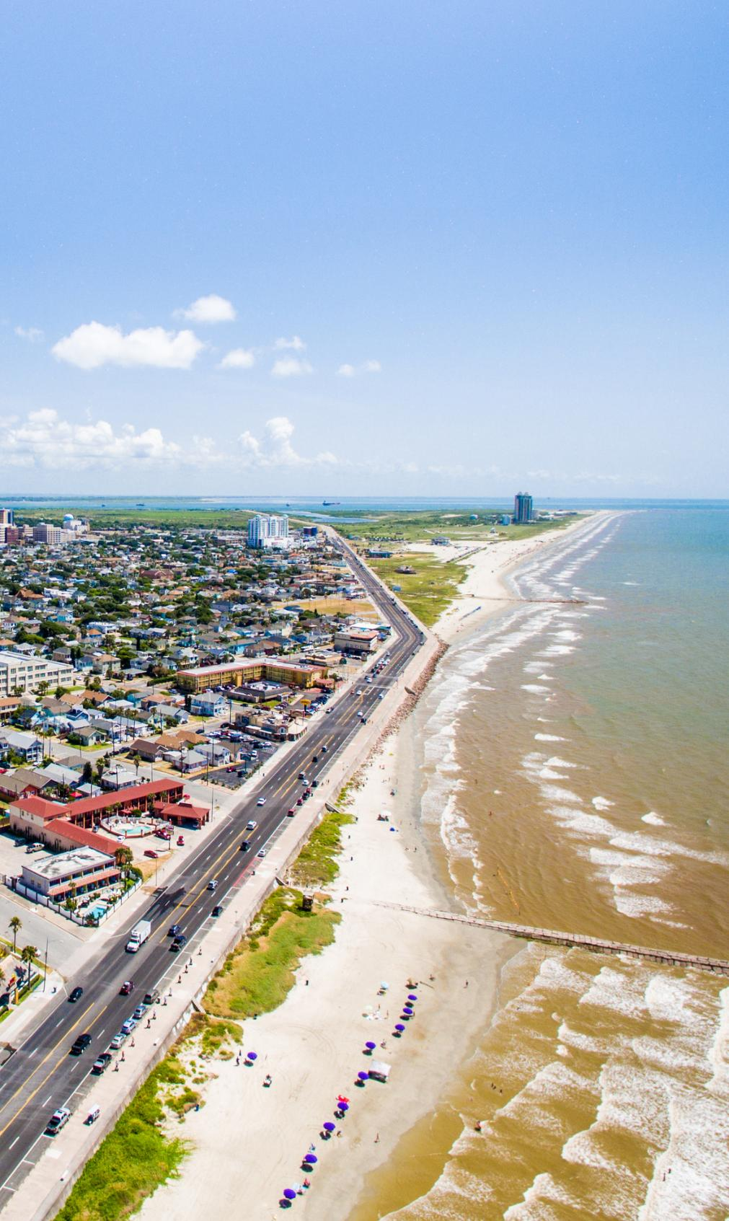
For more, see the Sea Level Rise module.
SEA-LEVEL RISE
SHIFTING PROPERTY BOUNDARIES
Severance v. Patterson (Tex. 2012)
  Texas’s rolling easement system allowed easements to adapt alongside gradual changes in property lines.
  A beachfront property owner challenged the rolling easement system after a hurricane caused public easements to suddenly move onto private property.
  The Texas Supreme Court determined that property lines were not affected but the state could establish new public easements to cope with future events.

Slide 31
For more, see the Fundamental Rights module.
CLIMATE RIGHTS
Climate rights cases commonly involve claims that the impacts of climate change are interfering with the right to life, liberty, property, due process, and in some states an express right to a clean and healthy environment. These claims are often paired with public trust arguments that establish a duty for the state to conserve common resources for present and future generations. Cases are based on:
Environmental Rights Amendments
Public Trust
Environmental Justice Laws
Climate Justice Laws
Seven U.S. states, including Pennsylvania, Montana, and Hawaii, guarantee the right to a clean, safe, and/or healthy environment through the state constitution
Procedural and substantive
Waiahole Case
(Haw.) includes an extensive discussion as applied to water resources
States with environmental justice laws include California, New Jersey, New York, and Washington, among others
In one example, Washington's Climate Commitment Act integrates environmental justice into climate planning

Slide 32
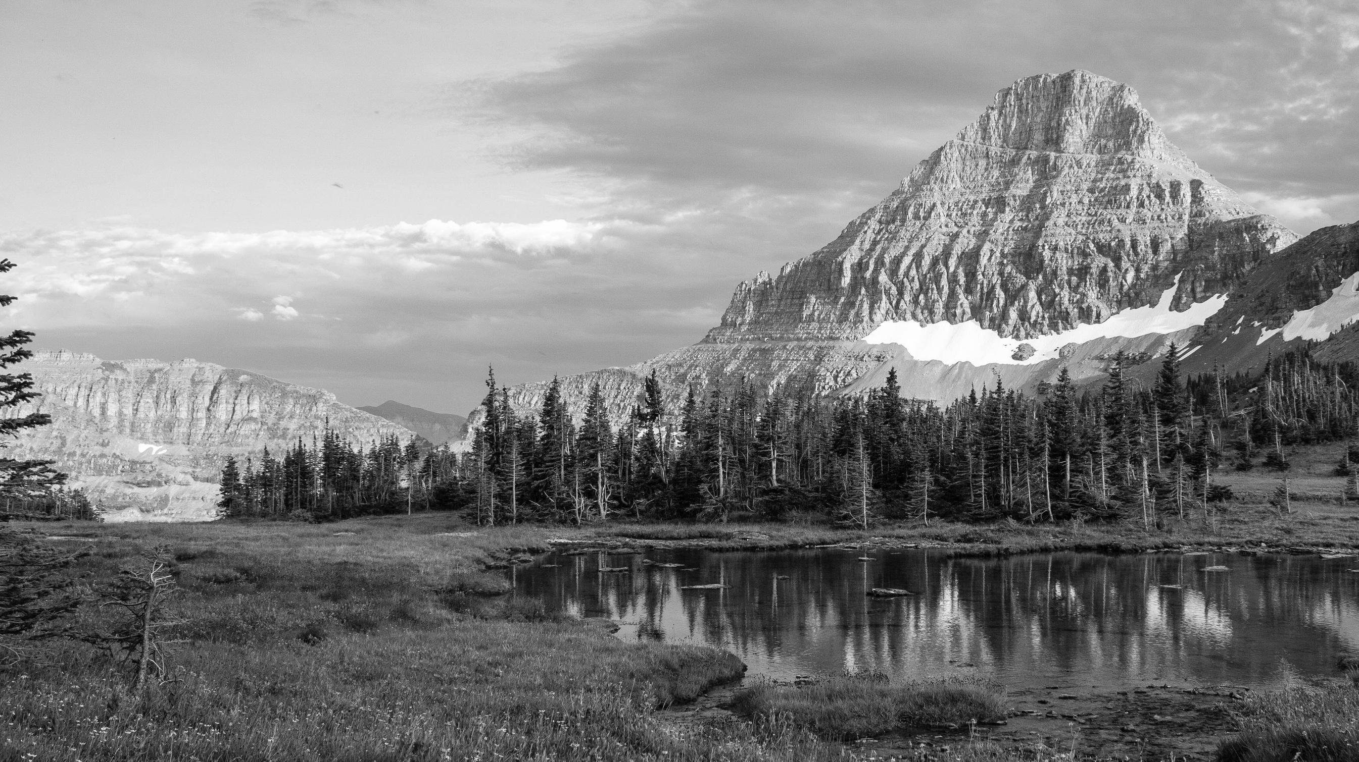
For more, see the Fundamental Rights module.
CLIMATE RIGHTS
HELD V. STATE OF MONTANA
The Montana Constitution singles out and elevates environmental rights, declaring an inalienable right to a healthful environment (Art. II, §3; Art. IX, §1)
A Montana trial court, in a decision upheld by the Montana Supreme Court, declared this "constitutional right to a clean and healthful environment, [] includes climate as part of the environmental life-support system."
Held v. State of Montana, No. CDV-2020-307, 102 (Mont. Dist. Ct. 2020)

Slide 33
For more, see the Procedural Techniques module.
CASE MANAGEMENT
WHAT COURTS CAN EXPECT TO SEE
Class Action
Multidistrict Litigation
Admissibility Hearings
Class action is often the more efficient form of action when large numbers of similarly situated plaintiffs request the same relief, particularly declaratory and injunctive relief.
Action may be appropriate
(1) when multiple lawsuits across the country allege the same claims against the same defendant or
(2) to resolve the admissibility of scientific evidence in multi-court tort suits against a single defendant.
Some of the science to arise in climate cases may require admissibility hearings.
These may determine whether the case can go forward.

Slide 34
For more, see the Procedural Techniques module.
CASE MANAGEMENT
TOOLS FOR JUDGES
Court-Appointed Experts
Tiered Discovery
Creative Settlements
Judges have appointed their own science experts and technical advisors to help them evaluate the parties’ arguments regarding their own and the other side’s experts.
Judges in toxic or mass torts cases, especially products liability cases, have engaged in multiple rounds of limited discovery to resolve key or critical fact issues.
As cases evolve, courts may employ non-traditional remedies such as adaptation funding, public health monitoring and treatment, and increased stakeholder participation in decision-making.

Slide 35

For more, see the Judicial Remedies module.
REMEDIES
U.S. climate cases implicate a broad array of remedies.
Injunctive Relief:
restrains a party from doing certain acts or requires a party to act in a certain way
Declaratory Relief:
states the rights of parties without ordering a specific action
Damages:
the payment of money in compensation for wrongdoing
Remand::
returns case to court or agency to proceed in accordance with opinion
Vacatur:
sets aside a judgment or proceeding (often used in conjunction with remand)
Civil Penalties:
fines prescribed by statute
Accounting::
derives from trust obligations to require trustees to record and make available information concerning trust property
Award of Costs and Attorney Fees:
to prevailing parties

Slide 36

For more, see the Judicial Remedies module.
REMEDIES
U.S. EXAMPLES
Comer v. Murphy Oil USA, Inc. (2012)
A federal district court in Mississippi dismissed plaintiffs’ putative class action seeking compensatory and punitive damages for the destruction of private and public property following Hurricane Katrina.
Kain v. Massachusetts Department of Environmental Protection (2016)
The Massachusetts Supreme Judicial Court declared that MassDEP was required by statute to adopt specific regulatory targets to reduce GHG emissions.
Lindstrom v. California Coastal Commission (2019)
A California Court of Appeal upheld several of the Commission’s conditions imposed on private coastline construction, including its setback provision. The court also ordered the Commission to delete or revise its condition requiring removal of the residence if any government agency orders that it not be occupied due to a natural hazard.

Slide 37

For more, see the Judicial Remedies module.
REMEDIES
INTERNATIONAL EXAMPLES
Urgenda Foundation v. State of the Netherlands (2015)
The District Court of the Hague ordered the Dutch government to reduce emissions 25% below 1990 levels by 2020.
Verein KlimaSeniorinnen Schweiz and Others v. Switzerland (2024)
The European Court of Human Rights declared that Switzerland breached its obligations under the European Convention of Human Rights (ECHR) by failing to adopt effective climate mitigation measures. It did not issue a specific remedial order under the ECHR.
Do-Hyun Kim et al. v. South Korea (2024)
The Constitutional Court of Korea ordered South Korea’s National Assembly to amend the 2021 Framework Act on Carbon Neutrality and Green Growth and set year-by-year emissions reduction targets for 2031 to 2049 by February 2026.

Slide 38

  3
ROLE OF CLIMATE SCIENCE IN CLIMATE LITIGATION

Slide 39
JUDICIAL TREATMENT OF CLIMATE SCIENCE
Climate science can relate to numerous legal issues and arise in a diverse array of cases, including:
STANDING
TORTS
ADMINISTRATIVE DECISIONMAKING
WILDLIFE AND HABITAT
ENVIRONMENTAL IMPACT ASSESSMENTS
FUNDAMENTAL RIGHTS
For more on climate science, see our Scientific Foundations of Climate Change modules.

Slide 40
JUDICIAL TREATMENT OF CLIMATE SCIENCE
Courts are increasingly engaging with climate science, but how that science is evaluated varies by jurisdiction as well as the legal and factual issues presented. This body of law is still developing, with many cases ongoing and new legal frameworks continuing to emerge.
Local Science
Variability
Just the Beginning
  Studies and reports
  Scientists and testimony
  Trial, appellate, and courts of last resort
  Differing standards of review
  Amount of science considered varies, even in record review cases
  Many cases with climate science in the record have yet to reach final judgment
  New laws and regs
  Siting projects

Slide 41
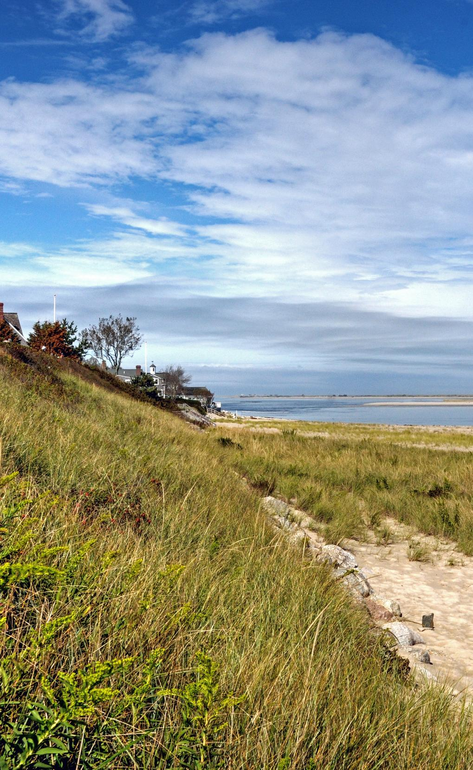
CLIMATE SCIENCE AND THE U.S. SUPREME COURT
The Commonwealth of Massachusetts led a challenge to U.S. EPA’s denial of a petition to regulate under the Clean Air Act greenhouse gas emissions (GHGs) from new motor vehicles.
Aspects of climate science were critical in the U.S. Supreme Court's determination that the Commonwealth had standing, including:
  Climate scientists' declarations
  Intergovernmental Panel on Climate Change (IPCC) reports
  GHG emissions accounting
Massachusetts v. EPA (2007)

Slide 42

CLIMATE SCIENCE ON TRIAL
Climate science played a key role at trial in Held v. State of Montana. The opinion relied on expert testimony about the causes of climate change, Montana’s greenhouse gas (GHG) emissions contributions to global climate change, and the impacts of climate change on children’s health, including on the plaintiffs.
Climate change is real, and it is human caused.
Montana’s emissions contribute to global climate change.
Climate threatens public health, and children specifically.
“There is overwhelming scientific consensus that Earth is warming as a direct result of human GHG emissions, primarily from the burning of fossil fuels.”
“Montana is a major emitter of GHG emissions in the world in absolute terms, in per person terms, and historically.”
“The unrefuted testimony at trial established that climate change is a critical threat to public health.”
Moreover, “[t]he physiological features of children make them disproportionately vulnerable to the impacts of climate change and air pollution.”
Listen to a podcast about the science in this case

Slide 43

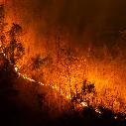






CLIMATE CONNECTIONS
These examples, from Held v. Montana, trace connections between climate change and harms. The strength of these connections may depend on the claims alleged, relief requested, and evidence presented.
Reduced snowpack
Wildfires
Skinny cows
Closed businesses and roads
Worse grazing conditions
Fewer customers
Reduced profits

Slide 44

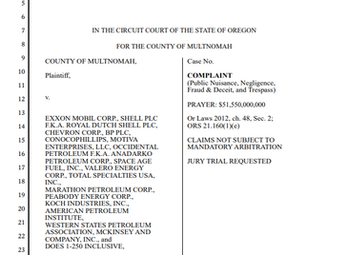
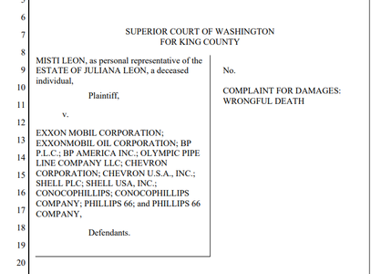
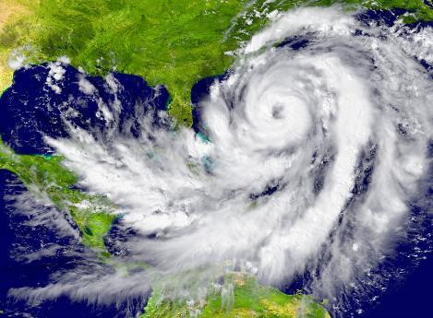
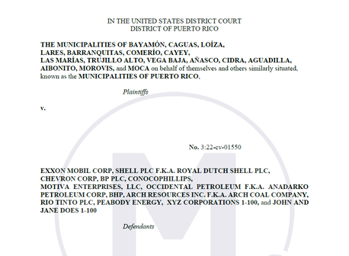
THE SCIENCE/LAW INTERSECTION
Lawsuits that involve specific events raise additional questions about source attribution and damages calculations. These lawsuits may consider questions such as whether, or to what extent, climate change played a role in the event.
Heatwave in Oregon
Hurricane(s) in Puerto Rico
County of Multnomah v. Exxon Mobil Corp.
Municipality of Bayamón v. Exxon Mobil Corp.
Leon v. Exxon Mobil Corp.

Slide 45

CLIMATE SUPERFUND LAWS
Vermont and New York have enacted climate superfund laws, modeled on the federal Superfund law (CERCLA). Vermont’s law relies on climate attribution science to identify responsible parties and calculate cost recovery amounts. The laws have been challenged in federal court, where litigation is ongoing.
Vermont’s Climate Superfund Act
Purpose? Money for climate adaptation projects
Who is a responsible party?
  Fossil fuel extractors and crude oil refiners
  VT Agency of Natural Resources can attribute 1 billion metric tons of covered GHGs between 1995 and 2024
How will this be determined? A combination of U.S. EPA data and rulemaking “adopting methodologies using available science and publicly available data”

Slide 46
KEY TAKEAWAYS
  1
  2
  3
More climate impacts means more cases involving climate change.
Climate science and law will interact in climate litigation.
Judges need resources to better prepare for the increase in climate cases.

