Slide 1
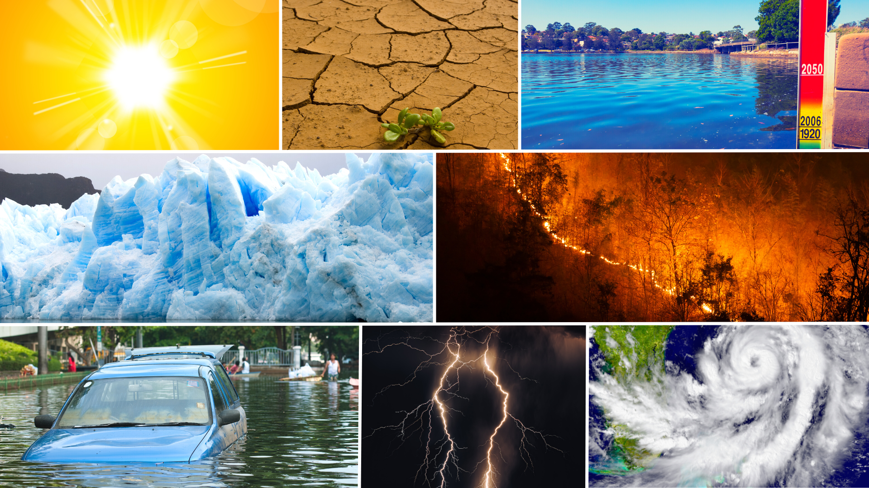
CLIMATE SCIENCE AND LAW FOR JUDGES:
CLIMATE SCIENCE 101
Updated: May 2023

Slide 2
ROADMAP
1
EARTH'S ENERGY BALANCE AND HUMAN INTERFERENCE
2
CLIMATE RISKS, IMPACTS, AND THEIR ATTRIBUTION
3
CLIMATE SOLUTIONS
4
CONCLUSION

Slide 3
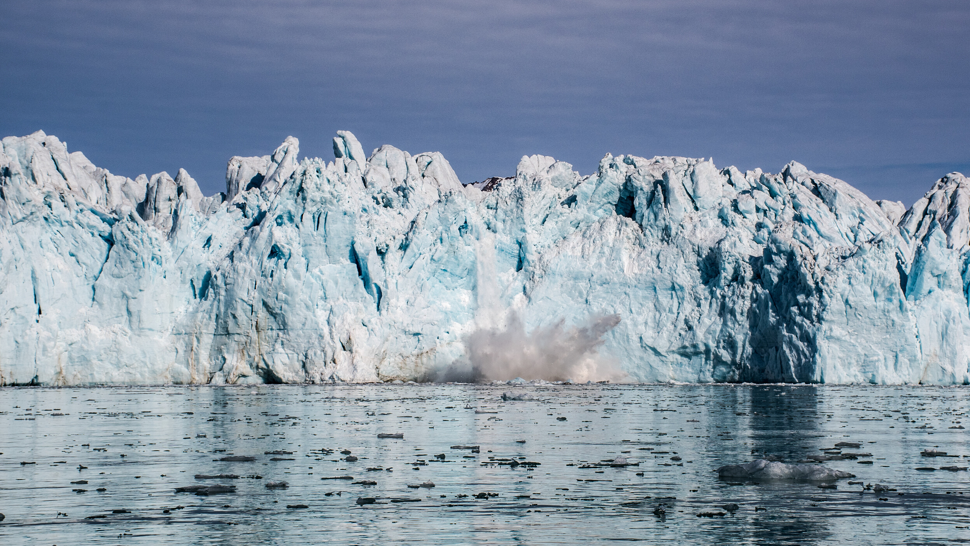
1
EARTH'S ENERGY BALANCE AND HUMAN INTERFERENCE

Slide 4
1
EARTH'S ENERGY BALANCE AND HUMAN INTERFERENCE
INTERGOVERNMENTAL PANEL ON CLIMATE CHANGE (IPCC)
The IPCC is the world's leading authority for assessing the science related to climate change. It consists of members from 195 countries, including the United States.
IPCC prepares comprehensive Assessment Reports about:
the state of scientific, technical and socio-economic knowledge on climate change,
its impacts and future risks, and
options for reducing the rate at which climate change is taking place
Notes:
Presenter notes:
Before we get started with the content, I want to make sure that everyone is made aware of the resources provided by the United Nations' Intergovernmental Panel on Climate Change, or IPCC.
The IPCC is the world's leading authority on climate science and is required to publish periodic assessment reports that evaluate the entire body of peer-reviewed scientific literature written about climate change.
These reports are composed by hundreds of independent scientists from around the world, and are reviewed by thousands more. The latest assessment cycle, culminating in Assessment Report 6, was completed in 2023.
I mention this because IPCC findings do feature heavily throughout this presentation and are considered the "gold standard" of climate science.

Slide 5
1
EARTH'S ENERGY BALANCE AND HUMAN INTERFERENCE
ENERGY BALANCE
AND THE GREENHOUSE EFFECT
Source: IPCC (1996) Working Group 1 contribution, Science of Climate Change, Second Assessment Report
Notes:
Presenter notes:
Climate is fundamentally driven by the Sun, which supplies the Earth with solar radiation.
Some of that solar radiation is reflected by the atmosphere and the Earth's surface, while a portion of it is converted to heat that warms the surface of the planet. Upon heating, longwave, or infrared, radiation is emitted back to the atmosphere, which gets absorbed and re-emitted back to Earth by gases, such as carbon dioxide, methane, and nitrous oxide.
Because they trap heat similar to a greenhouse, such gases are commonly called "greenhouse gases." And, without this atmospheric "greenhouse effect," the Earth's surface would be much cooler and life as we know it would not exist.
Since the industrial revolution, human activity has increased the concentration of these gases in the atmosphere, which in turn has caused global climate to change.
Climate scientists are virtually unanimous in this finding, and they have confidence in it for many reasons.

Slide 6
1
EARTH'S ENERGY BALANCE AND HUMAN INTERFERENCE
GLOBAL TEMPERATURE ANOMALY
Source: Figure from Climate Central, data from NASA GISS
Notes:
Presenter notes:
NASA data indicate that the average temperature of the Earth has been increasing over the last century.
This plot shows the departure from average temperature conditions from the period of 1881 to 1910. The Earth has warmed by about 1.2 C, or 2.16 F, on average over this period.

Slide 7
1
EARTH'S ENERGY BALANCE AND HUMAN INTERFERENCE
CARBON DIOXIDE (CO ) AND TEMPERATURE
2
Variations in atmospheric carbon dioxide levels contributed to changes in temperature throughout geological history
Modern levels of atmospheric carbon dioxide are unprecedented on this time scale due to human activity
Source: Nat'l Acad. of Sci. & The Royal Soc'y, Climate Change: Evidence & Causes Update 2020, at 10 (2020)
Notes:
Presenter notes:
Ice-core reconstructions of atmospheric carbon dioxide levels and temperature show that this greenhouse gas has long been important for regulating global temperature.
While changes in Earth's orbit were also important for regulating the climate on this longer geological timescale, these orbital changes operate over periods of thousands and tens of thousands of years, and cannot explain the relatively rapid rate of temperature increase characteristic of the last century.
The Earth has been warmer than today in its geological history. However, the rate of temperature increase over the post-industrial era is likely unprecedented over this interval. (Note that the reason we do note see an accompanying dramatic increase in the temperature record is because temperature anomaly is plotted here, which is the departure of temperature from average conditions over the last 800,000 years.)

Slide 8
1
EARTH'S ENERGY BALANCE AND HUMAN INTERFERENCE
INCREASING ATMOSPHERIC CO
2
Changes in Atmospheric Carbon Dioxide over Time
Dramatic rate of increase of CO occurred at the start of the industrial revolution
2
Source: Benjamin Strauss, The Carbon Skyscraper, Climate Central (2021)
Source: NOAA, Global Monitoring Laboratory (2022)
Notes:
Presenter notes:
Human activity, predominantly through the use of fossil fuels for energy, land use, and agriculture, has dramatically increased the concentration of carbon dioxide in the atmosphere.
The plot on the left represents changes in atmospheric CO2 per 1000 years over the last 800,000 years. The spike at the end of this graph, or the "carbon skyscraper," represents the last 100 years.
In addition to these paleo-reconstructions of CO2, we also have direct observations of this increasing trend that extend back to 1958, as demonstrated by the plot on the right.
So, CO2 is increasing rapidly and so is temperature. But these facts on their own are not sufficient to show that the temperature increase is caused by CO2.

Slide 9
1
EARTH'S ENERGY BALANCE AND HUMAN INTERFERENCE
DETECTION AND ATTRIBUTION
A central issue in both climate science and the law is the attribution of effects to causes
DETECTION
ATTRIBUTION
Detect that the climate has changed by documenting an observable change in a particular climate measure
Attribute that change to causal factors
Notes:
Presenter notes:
A central issue in both climate science and the law is the attribution of effects to causes.
The detection and attribution of climate change constitute an exercise in causality.

Slide 10
1
EARTH'S ENERGY BALANCE AND HUMAN INTERFERENCE
GLOBAL AVERAGE TEMPERATURE (DETECTION)
The most obvious signal of climate change is global mean surface temperature
Demonstrates a detectable increase in global mean surface temperature coincident with the rise in CO
2
Source: Berkeley Earth
Notes:
Presenter notes:
Detection refers to observing a trend in a given climate variable, such as the one in global mean surface temperature shown here.

Slide 11
1
EARTH'S ENERGY BALANCE AND HUMAN INTERFERENCE
OTHER CLIMATE SIGNALS (DETECTION)
A clear warming trend since
the industrial era is indicated
by other climate signals, including:
Ocean heat content
Sea level rise
Source: Nat'l Acad. of Sci. & The Royal Soc'y, Climate Change: Evidence & Causes Update 2020, at 4 (2020)
Notes:
Presenter notes:
In addition to global mean surface temperature, there are several other detectable climate signals that are indicative of a warming climate.
Two such examples include ocean heat content and sea-level rise, shown here.

Slide 12
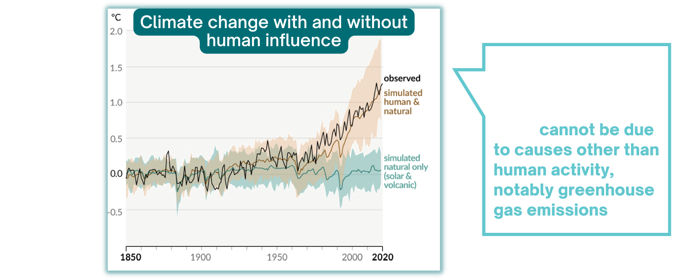
1
EARTH'S ENERGY BALANCE AND HUMAN INTERFERENCE
IDENTIFYING HUMAN INFLUENCE (ATTRIBUTION)
Source: IPCC, Climate Change 2021: The Physical Science Basis, Summary for Policymakers (2021) (Figure SPM.1 (b)).
Notes:
Presenter notes:
Once a trend is identified, the next step is to attribute it to a cause. Using multiple lines of independent evidence, including a combination of direct observations, paleoclimate reconstructions, and sophisticated climate models, climate scientists have consistently found that recent warming cannot be explained by anything other than human activity.
Pictured here is one example of such a finding that uses multiple climate models from the IPC. These models were developed by independent scientists from around the world, and simulate Earth's historical climate with (orange) and without (green) human activity. The black curve represents temperature observations. The results show that, without human activity, no significant warming trend would be expected.
However, when we do include human activity in the models, they reproduce the observed temperature trend well. Such evidence, and the decades of scientific research that underly our understanding of the climate system, has allowed climate scientists to conclude, virtually unanimously, that human activity is responsible for recent warming.

Slide 13
1
EARTH'S ENERGY BALANCE AND HUMAN INTERFERENCE
OUR CHOICES
MATTER FOR
FUTURE CLIMATE
Climate Change Scenarios
Source: Nat'l Acad. of Sci. & The Royal Soc'y, Climate Change: Evidence & Causes Update 2020, at B8 (2020)
Notes:
Presenter notes:
We know that human activity is driving climate change. However, we don't know quite how warm it will get, largely because of uncertainties in future emissions.
This plot shows the impact of two different emissions scenarios on future global temperature: one in which emissions are aggressively reduced and temperature increase is relatively muted (blue), and one in which emissions are not curbed (orange).
The main takeaway here is that our choices matter for the future of the climate.

Slide 14
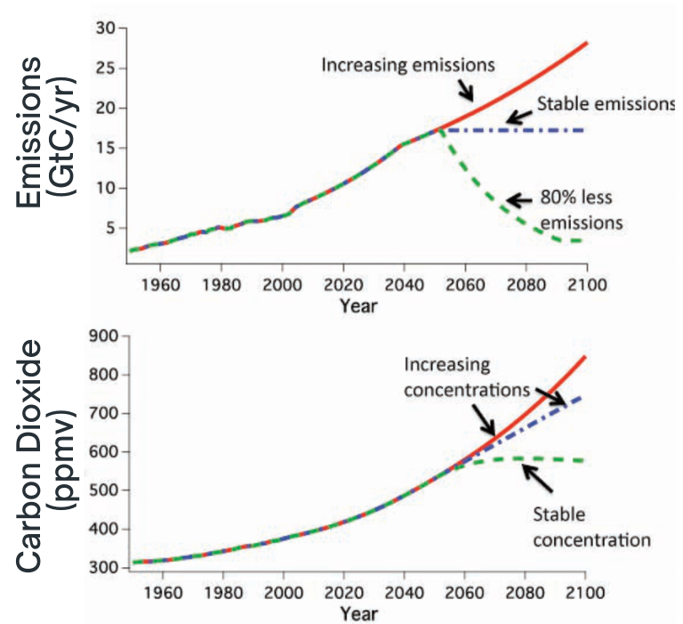
1
EARTH'S ENERGY BALANCE AND HUMAN INTERFERENCE
HUMAN EMISSIONS AND ATMOSPHERIC CO
2
CO remains in the atmosphere for hundreds of years. Therefore, our past and present emissions have guaranteed a certain degree of warming.
This is also why stabilizing emissions does not stabilize atmospheric levels of CO . In fact, an 80% reduction in emissions is required for that.
2
2
Source: Nat'l Acad. of Sci., Eng'g & Med., Climate Stabilization Targets (2010) (Figure Syn 4).
Notes:
Presenter notes:
The graph on the top represents three different emissions scenarios, shown in gigatons of carbon (GtC): an increase in emissions, a stablization of emissions, and an 80% reduction in emissions.
The bottom plot shows the impact of these emissions scenarios on atmospheric CO2 levels (denoted by the same-colored lines).
Stabilizing emissions does not stabilize atmospheric levels of CO2. You can see that when comparing the top and bottom graphs. Stabilizing emissions (the blue dotted line in the top graph), will still mean a continued increase in the concentration of CO2 (see the increasing blue dotted line in the bottom graph)

Slide 15
2
CLIMATE RISKS, IMPACTS, AND THEIR ATTRIBUTION
Notes:
Presenter notes:
Why should anyone actually care about an increase in global mean surface temperature?
The reason is because that temperature increase also brings along increased risk to human and natural systems in the form of climate impacts.

Slide 16
2
CLIMATE RISKS, IMPACTS, & THEIR ATTRIBUTION
CONCEPTUAL FRAMEWORK OF CLIMATE RISK
Risks result from the interaction of hazards with people and ecosystems that are exposed and vulnerable and that respond in different ways.
Vulnerability
(e.g., can't afford evacuation)
Hazard
(e.g., sea-level rise)
Risks
Actions to reduce hazards, exposure, and vulnerability
Climate-resilient development should consider all three.
Exposure
(e.g., coastal populations)
Adapted from IPCC (2022)
Notes:
Presenter notes:
Risk to the impacts of climate change are a function of the climate change hazard itself (e.g., rising sea levels), exposure to that hazard (e.g., coastal populations), and various vulnerability factors that limit a certain demographic group's ability to mitigate against risk (e.g., people who can't afford to evacuate).

Slide 17
2
CLIMATE RISKS, IMPACTS, & THEIR ATTRIBUTION
GLOBAL CLIMATE RISKS UNDER DIFFERENT WARMING SCENARIOS
Warming
Risks increase with increasing levels of warming
Unique and threatened systems
Extreme weather events
Distribution of impacts
Global aggregate impacts
Large scale singular events
Reasons for concern
Source: IPCC (2022)
Notes:
Presenter notes:
When it comes to specific climate risks, the IPCC has identified various reasons for concern associated with changes to unique and threatened systems, extreme weather events, the distribution of impacts, global aggregate impacts, and large-scale singular events.
These risks, the IPCC notes, all increase with increasing levels of warming.

Slide 18
2
CLIMATE RISKS, IMPACTS, & THEIR ATTRIBUTION
ISSUES OF GEOGRAPHICAL JUSTICE
Maps of the world with country sizes corresponding to:
(A) relative proportions of cumulative carbon dioxide emissions by country
(B) the magnitude and severity of climate-related mortality including malaria, malnutrition, and inland flood-related drownings by country
The global north is responsible for most emissions, but the global south suffers most impacts
Adapted from Jonathan A. Patz et al., Climate Change and Global Health: Quantifying a Growing Ethical Crisis, 4 ECOHEALTH 397, 400 (2007)
Notes:
Presenter notes:
It's also important to be aware of the various dimensions of justice issues related to climate risks.
At the heart of these justice issues is the fact that climate change impacts will be felt differently by different groups of people and different regions of the world.
For example, cumulative greenhouse gases were disproportionately emitted by the global north, but the global south will experience a disproportionate degree of the impacts of climate change.

Slide 19
2
CLIMATE RISKS, IMPACTS, & THEIR ATTRIBUTION
ISSUES OF GENERATIONAL JUSTICE
Climate extremes will get worse over time, so young people and future generations will suffer disproportionately from impacts
darker color = higher emissions scenario
Source: IPCC, AR6 Synthesis Report: Climate Change, Summary for Policymakers (2023) (Figure SPM.1 (c))
Notes:
Presenter notes:
Because climate impacts will intensify in the future, they will also manifest disproportionately on younger generations.
This IPCC schematic shows the change in temperature during the life expectancy of someone born in 1950 vs. someone born in 2020.
Someone born in 2020 will likely suffer more from climate impacts compared to someone born in 1950, but the disparity between these generations will depend largely on our current and future emissions decisions.
For example, compare the head of the 70-year-old in 2090, representing temperature consistent with a "very high emissions scenario," to their feet, representing temperature consistent with a "very low emissions scenario."

Slide 20
2
CLIMATE RISKS, IMPACTS, & THEIR ATTRIBUTION
HEALTH IMPACTS ON VULNERABLE POPULATIONS
Source: IPCC, AR6 Synthesis Report: Climate Change, Summary for Policymakers (2023) (Figure SPM.1 (c))
Notes:
Presenter notes:
It isn't just young people at risk from climate change. Different climate impacts will also affect rural communities, elderly individuals, and low-income communities disproportionately.
It's noteworthy to mention that this list is not comprehensive, and that there are other demographic groups that are also disproportionately vulnerable to various climate impacts.

Slide 21
2
CLIMATE RISKS, IMPACTS, & THEIR ATTRIBUTION
INCREASING ECONOMIC IMPACTS
Source: NOAA, Climate.gov (2022)
Notes:
Presenter notes:
Climate impacts are also affecting, and will continue to affect, the economy.
Looking at billion-dollar weather and climate events throughout the course of history, we can see that the CPI-adjusted economic impacts of these disasters is increasing.
This is due to both an increase in the hazards associated with climate change, but also an increase in exposure to climate- and weather-related disasters.

Slide 22
2
CLIMATE RISKS, IMPACTS, & THEIR ATTRIBUTION
THE COSTS OF CLIMATE CHANGE
Estimates of Direct Economic Damage from Temperature Change
Rising cost of climate damages with increasing levels of warming
Source: U.S. Global Change Research Program (USGCRP), Fourth National Climate Assessment Vol. II: Impacts, Risks, and Adaptation in the United States (2018) (Figure 29.3)
Notes:
Presenter notes:
This 2018 report from the federal government looked at how emissions scenarios, shown on the left of the figure, will impact the country's GDP, shown on the right.
Higher emissions scenarios, which result in higher temperatures, also result in higher estimates of direct economic damage to the US.

Slide 23
2
CLIMATE RISKS, IMPACTS, & THEIR ATTRIBUTION
CHANGING BASELINES
Temperature Change by Decade
-4
-2
0
2
4
Temperature Anomaly (ºC)
Source: NASA, Shifting Distribution of Land Temperature Anomalies, 1951-2020 (2021)
Notes:
Presenter notes:
This NASA figure depicts the change in Earth's temperature over seven decades.
Temperature is getting warmer on average (which is represented by the peak of each of these curves for a given decade), but the whole distribution of temperature is also shifting. You can see this shift as the curve moves to the right over time. In practical terms, this means higher highs and higher lows, on the global average.
This shift toward heating has made it more likely for some extreme events to intensify, such as heatwaves.

Slide 24
2
CLIMATE RISKS, IMPACTS, & THEIR ATTRIBUTION
THE HUMAN INFLUENCE ON HEAT WAVES
Example of attributing intensified heatwaves to human-caused climate change
The causal link between human-caused climate change and some extreme events, like heatwaves, is so well-established that scientists can isolate the fingerprint of climate change on them.
Adapted from Michael Wehner et al., Early 21st Century Anthropogenic Changes in Extremely Hot Days As Simulated by the C20C+ Detection and Attribution Multi-model Ensemble, 20 Weather & Climate Extremes 1 (2018)
Notes:
Presenter notes:
Using climate models that run simulations of heatwaves with and without human-caused climate change, scientists can calculate the effects of human-caused warming on the severity of heat waves.
Shown here is a plot of that influence across the United States, showing the attributable human temperature increase in rare heat waves.
This is an example of an "impact attribution study," and is a part of the rapidly developing field of attribution science.

Slide 25
2
CLIMATE RISKS, IMPACTS, & THEIR ATTRIBUTION
ATTRIBUTION SCIENCE
Global Climate Change
Physical Impacts
Source
Harm
Source Attribution
Global Climate
Change Attribution
Impact Attribution
Event Attribution
Source: climateattribution.org
Notes:
Presenter notes:
There are four areas of attribution science that attempt to establish a causal nexus between greenhouse gas emissions and harm, and thus are particularly relevant for judicial decision-making.
The first is source attribution, which characterizes the extent to which emissions of a particular source, such as a government or company, contribute to climate change.
The second is global climate change attribution, which characterizes the degree to which emissions contribute to global changes in Earth's climate system, such as sea-level rise.
Third, there is impact attribution, like in the US heatwave example, characterizing the effects of climate change on general physical impacts.
And fourth is event attribution, characterizing the influence of climate change on a given event, such as a specific heatwave.

Slide 26
3
CLIMATE SOLUTIONS
Notes:
Presenter notes:
On the climate change problem, there is some room for hope.

Slide 27
3
CLIMATE SOLUTIONS
Path to net-zero greenhouse gas (GHG) emissions by 2050, by gas
NET ZERO EMISSIONS
BY 2050 IS POSSIBLE
CO2
Non-CO2 gases
Land sinks
One pathway to net-zero emissions by 2050:
Deep reduction in carbon dioxide emissions
Moderate declines in non-carbon dioxide greenhouse gas emissions
Expansion of land carbon sinks
Expansion of negative emissions technologies
Source: Nat'l Acad. of Sci. Eng'g and Med, Accelerating Decarbonization of the U.S. Energy System 58 (2021)
Notes:
Presenter notes:
To avoid the worst impacts of climate change, over 190 countries, including the United States, have signed the Paris Agreement of the United Nations. This agreement calls for limiting global warming to "well below" 2 degrees Celsius (3.6 degrees Fahrenheit) relative to preindustrial levels, and to pursue efforts to reduce the increase to 1.5 degrees C relative to preindustrial levels.
To achieve this goal, the United States and other countries would need to reach net-zero greenhouse gas emissions by mid-century, meaning that any remaining emissions would need to be balanced by negative-emissions technology like carbon capture and storage.
In a 2021 report, the National Academies of Sciences outlined potential pathways to accomplish this goal.
Regardless of which policies are implemented, it is clear that net-zero emissions by 2050 would require a deep reduction in carbon dioxide emissions, reductions in other greenhouse gas emissions, and an expansion of carbon capture efforts.

Slide 28
3
CLIMATE SOLUTIONS
ENERGY
TRENDS
In recent years, subsidies have lowered the cost and increased the competitiveness of renewable energy resources
Value of Energy Tax Incentives, by Energy Resource
Source: Cong. Rsch. Serv., R44852, The Value of Energy Tax Incentives for Different Types of Energy Resources 10 (Mar. 19, 2019) (Figure 1)
Notes:
Presenter notes:
Importantly, global energy demand must continue to be met while we reduce emissions.
Renewable sources of energy, like solar and wind, could likely play a critical role.
In recent years, a combination of government action and the free market have worked together to dramatically reduce the cost of these energy sources such that they are now the cheapest on the market.
However, additional expansion of renewables would be required to meet net-zero goals by 2050.

Slide 29
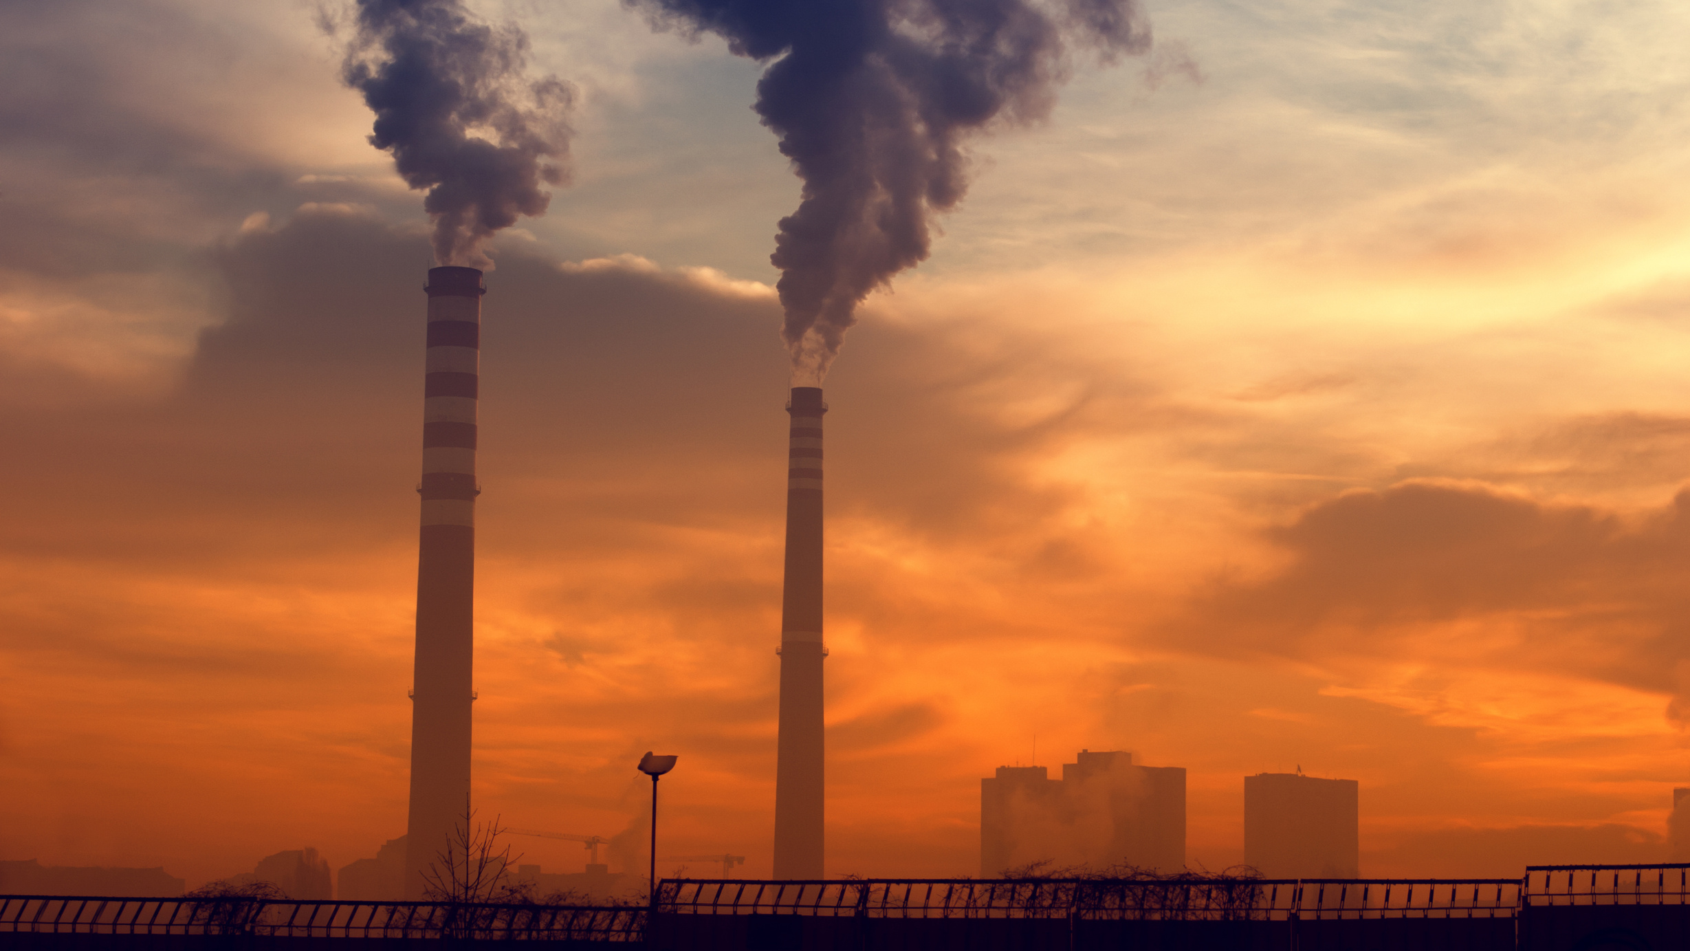
4
CONCLUSION

Slide 30
6
CONCLUSION
KEY TAKEAWAYS
1
2
3
Levels of heat-trapping greenhouse gases in the atmosphere, arising mostly from human activity, will be the most important determinant of risks and impacts that occur
Climate change will have widespread social, economic, and health impacts and will be disproportionately borne by marginalized and underserved communities
Climate science will be instrumental in advancing adaptation, mitigation, and detection and attribution of climate impacts

Slide 31
CLIMATE JUDICIARY PROJECT
RESOURCES
Climate Science and Law for Judges Curriculum
Providing judges and the judiciary with reliable and up-to-date information about the legal and scientific issues in the climate litigation of today and tomorrow

Slide 32
CONTACT US
Climate Judiciary Project
https://www.cjp.eli.org
cjp@eli.org

Slide 33
RESOURCES
U.S. Global Change Research Program, Fourth National Climate Assessment
Vol. 1: Climate Science Special Report
Vol. 2: Impacts, Risks, and Adaptation in the United States
Intergovernmental Panel on Climate Change, Sixth Assessment Report
Climate Change 2022: Mitigation of Climate Change
Climate Change 2022: Impacts, Adaptation and Vulnerability
Climate Change 2021: The Physical Science Basis
AR6 Synthesis Report: Climate Change 2023
National Academies of Science, Engineering, and Medicine
Climate Change: Evidence and Causes: Update 2020 (2021)
Climate Stabilization Targets (2010)
Accelerating Decarbonization of the U.S. Energy System (2021)
Attribution of Extreme Weather Events in the Context of Climate Change (2016)
NOAA
State Climate Summaries
State of the Climate, Monthly Reports
Academic Journal Articles
Jonathan A. Patz et al., Climate Change and Global Health: Quantifying a Growing Ethical Crisis, 4 ECOHEALTH 397, 400 (2007)
Andy Haines & Kristie Ebi, The Imperative for Climate Action to Protect Health, 380 NEJM 263 (2019)
Michael Wehner et al., Early 21st Century Anthropogenic Changes in Extremely Hot Days As Simulated by the C20C+ Detection and Attribution Multi-model Ensemble, 20 Weather & Climate Extremes (2018)

